Slide 1
Chapter 5 Network and Transport Layers
Part 2

Slide 2
Chapter 5 Outline
Transport & Network Layer Protocols
TCP/IP
Transport Layer Functions
Linking to the Application Layer
Segmenting
Session management
Addressing
Assigning addresses and address resolution
Routing
Types of routing, routing protocols, and multicasting
TCP/IP Examples
Copyright 2010
John Wiley & Sons, Inc

Slide 3
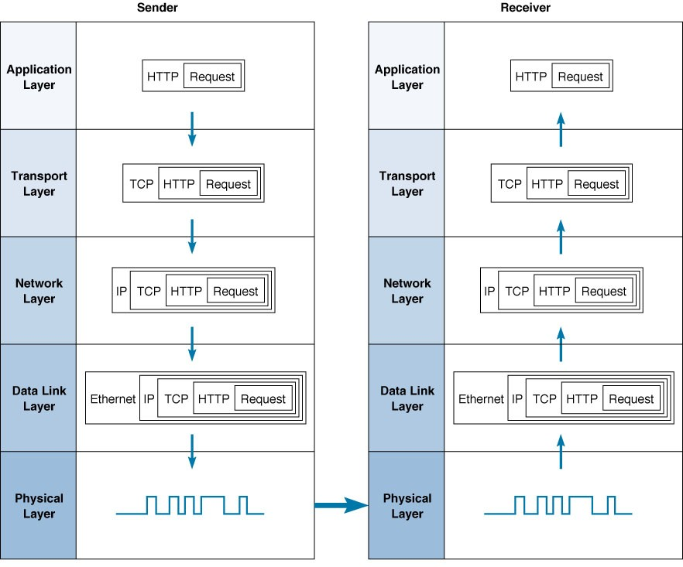
Network Layers
Computer 1
Computer 2

Slide 4
Transport Layer Functions
Segmenting
Linking to the Application Layer
Session management
Connection-oriented
Connectionless
Quality of Service (QoS)
Application Layer
Transport Layer
Network Layer

Slide 5
5.2.3.1 Session Management - Connection Oriented
Setting up a virtual circuit, or a TCP connection
Packet deliveries are acknowledged
For which application layer packets does the transport layer use a connection oriented session for?

Slide 6
5.2.3.2 Session Management - Connectionless Routing
Provided by UDP
Sending packets individually without a virtual circuit
Each packet is sent independently of one another, and will be routed separately, following different routes and arriving at different times
For which application layer packets does the transport layer use a connection oriented session for?

Slide 7
5.2.3.2 UDP - User Datagram Protocol
Protocol used for connectionless routing in TCP/IP suite that uses no acks, no flow control
Uses only a small packet header
Only 8 bytes containing only 4 fields:
Source port
Destination port
Message length
Header checksum
Can also be used for applications where a packet can be lost, such as information rich video

Slide 8
5.2.3.3 Protocols Supporting QoS
Asynchronous Transfer Mode (ATM)
A high-speed data link layer protocol
TCP/IP protocol suite
Resource Reservation Protocol (RSVP)
Sets up virtual circuits for general purpose real-time applications
Real-Time Streaming Protocol (RTSP)
Sets up virtual circuits for audio-video
applications
Real-Time Transport Protocol (RTP)
Used after a virtual connection setup by RSVP or RTSP
Adds a sequence number and a timestamp for helping applications to synchronize delivery
Uses UDP (because of its small header) as transport
RSVP
RTSP
RTP
UDP
IP

Slide 9
Network Layer Functions
Addressing
Each device on the path between source and destination must have an address
Internet Addresses
Assignment of addresses
Translation between network layer
addresses and other addresses
(address resolution)
Routing
Process of deciding what path a packet must take to reach destination
Routing protocols
Transport Layer
Network Layer
Data Link Layer

Slide 10
5.3.1 Types of Addresses
Application Layer Address
Network Layer Address
Data Link Layer Address
Application Layer
Transport Layer
Network Layer
Data Link Layer

Slide 11
5.3.1 Types of Addresses
Address Type
Example
Example Address
Analogy
Application Layer
URL
www.iub.edu
Name
Network Layer
IP address
129.79.127.4 (4 bytes)
Zip code
Data Link Layer
MAC address
00-0C-00-F5-03-5A
(6 bytes)
Street
address
These addresses must be translated from one type to another for a message to travel from sender to receiver.
This translation process is called address resolution.

Slide 12
5.3.1 Question: Addresses and Clients
How many addresses are assigned to the different computers in this room?
Desktop
Laptop

Slide 13
5.3.2 Assignment of Addresses
Data Link Layer Address (MAC address)
Unique hardware addresses placed on network interface cards by their manufacturers ( based on a standardized scheme)
How are these set?
What do you they look like?
http://www.coffer.com/mac_find/

Slide 14
5.3.2 Assignment of Addresses
Application Layer address (URL)
For servers only (clients don’t need it)
Assigned by network managers and placed in configuration files.
Some servers may have several application layer addresses
Network Layer Address (IP address)
Assigned by network managers, or by programs such as DHCP, and placed in configuration files
Every network on the Internet is assigned a range of possible IP addresses for use on its network

Slide 15
5.3.2 Internet Addresses
Managed by ICANN
Internet Corporation for Assigned Names and Numbers
Manages the assignment of both IP and application layer name space (domain names)
Both assigned at the same time and in groups
Manages some domains directly (e.g., .com, .org, .net) and
Authorizes private companies to become domain name registrars as well
Example: UNCW
URL that end in .uncw.edu
IP addresses in the 152.20.x.x range (where x is any number between 0 and 255)

Slide 16
5.3.2 How do you decide who gets what address?
Group of computers on the same LAN with IP numbers using the same prefix
Assigned addresses
For example:
Subnet 152.20.234.x
Computers in CIS labs (x is between 0 & 255)
Subnet 152.20.244.x & 152.20.196.x
Computers in CIS Offices (x is between 0 & 255)
Subnet 129.79.125.x
Computers in Cameron
Does anyone see a problem with the subnets above?

Slide 17
5.3.2 Subnets: Example

Slide 18
5.3.2 Subnets
How do you think UNCW handles assigning address?
How does the server know where to send the IP address if it doesn’t have one?

Slide 19
5.3.2 Dynamic Addressing
Giving addresses to clients (automatically) only when they are logged in to a network
Uses a server to supply IP addresses to computers whenever the computers connect to network

Slide 20
5.3.2 Programs for Dynamic Addressing
Protocols:
Bootstrap Protocol (bootp)
Dynamic Host Control Protocol (DHCP)
Different approaches, but same basic operations:

Slide 21
5.3.3 Address Resolution
Server Name Resolution
Data Link Layer Address Resolution

Slide 22
5.3.3 Server Name Resolution - DNS
Used to determine IP address for a given URL
Provided through a group of name servers
Databases containing directories of domain names and their corresponding IP addresses
Large organizations maintain their own name servers
smaller organizations rely on name servers provided by their ISPs
When a domain name is registered, IP address of the DNS server must be provided to registrar for all URLs in this domain
Example: Domain name: uncw.edu
URLs: www.uncw.edu, csb.uncw.edu, www.uncw.edu/cas/index.html

Slide 23
5.3.3 How DNS Works – Directory Service
Where are address tables located?

Slide 24
5.3.3 How DNS Works (Cont.)
If the URL is NOT in the local DNS server
Sends DNS request packet to the next highest name server in the DNS hierarchy
Usually the DNS server at the top level domain (such as the DNS server for all .edu domains)
If the URL is NOT in the name server
Sends DNS request packet ahead to name server at the next lower level of the DNS hierarchy

Slide 25
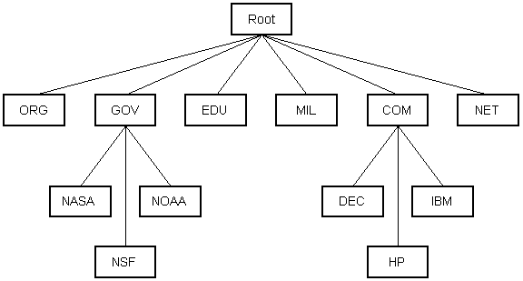
5.3.3 DNS Hierarchy

Slide 26
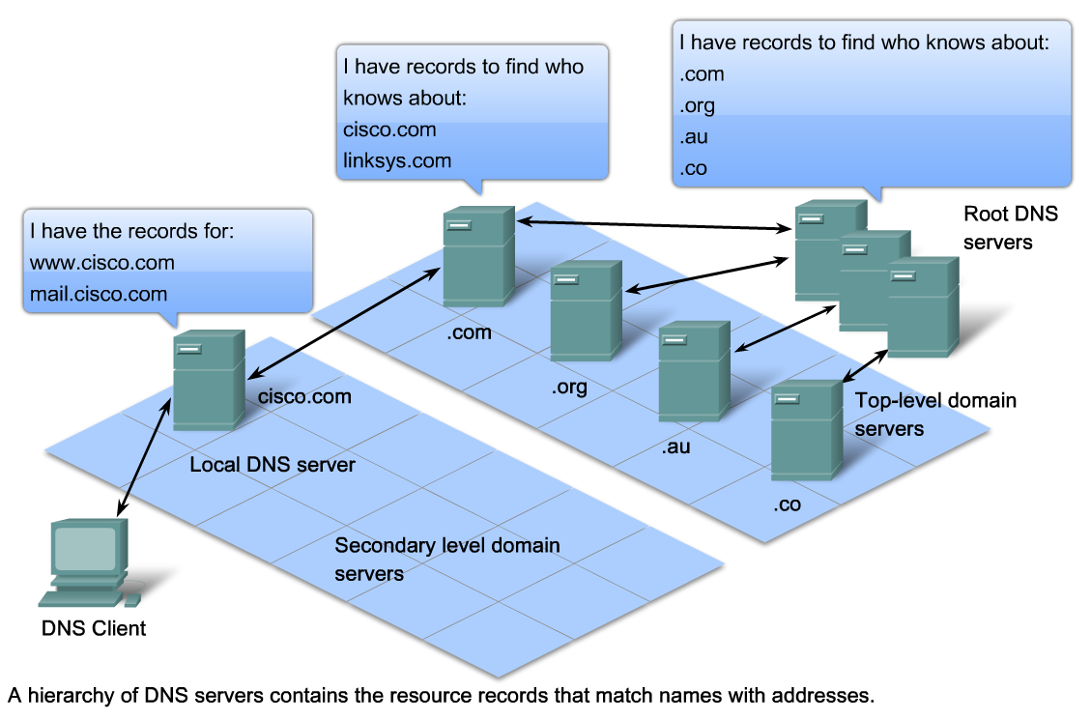
5.3.3 DNS Hierarchy
http://www.root-servers.org/

Slide 27
5.3.3 How DNS Works – Internal Request

Slide 28
5.3.3 How DNS Works – External Request

Slide 29
5.3.4 MAC Address Resolution
Problem: Unknown MAC address of the next node (whose IP address is known)
Solution:
Operation:

