Slide 1
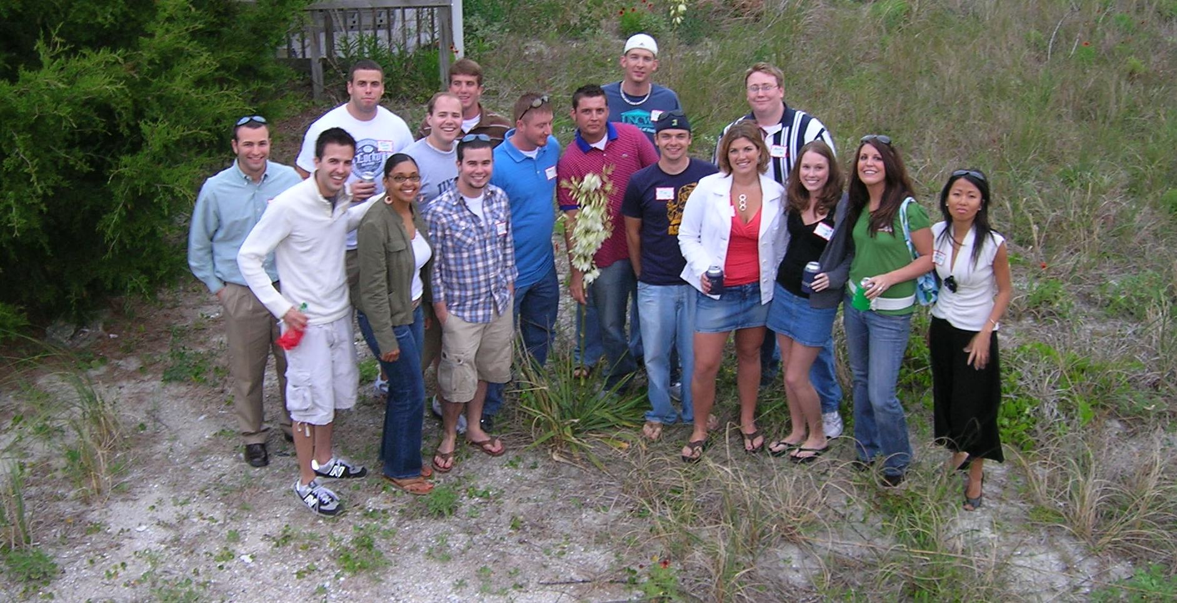
Careers in Information Systems
The IS Concentration at UNCW

Slide 2
Why Concentrate In Information Systems? or consider a double concentration!

Slide 3
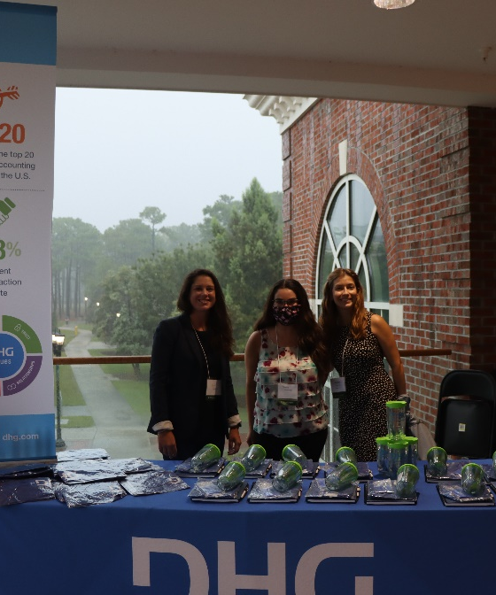
IS grads are in demand
NC Tomorrow projects 23,000 new IT jobs will be needed in North Carolina in the next 10 years (3rd highest growth occupation)
http://www.nctomorrow.com

Slide 4
IS grads are in demand and are paid for being in demand
IT Professions have 5 of the top 10 growth jobs in the next 10 years
Source: US Bureau of Labor Statistics for jobs paying more than $46,360.

Slide 5
Why concentrate in IS?
We get to play with technology!
Field that challenges its professionals to grow, learn, and take advantage of technology
Places you in an unique position in an organization to assist all departments with their problems and get recognized for your effort
Is a STEM concentration

Slide 6
IS Concentration
Software Developer / Engineer
Project Manager
Business / System Analyst
Data Managers

Slide 7
Business Analysts
Create solutions using technology to solve corporate problems or increase profitability
Link between business and technology
Design / Implement Technology Solutions
Train users
Typical Employers: LiveOak, MetLife, Fidelity Investments EY, Deloitte

Slide 8
IT Project Managers
Lead teams to manage projects to be completed on time, on budget and within user needs
Typical Employers: Central Square, UNCW, NetApp

Slide 9
Application Developers / Software Engineers
Build the actual systems to improve the workflow or profitability of organizations
Write code in various languages and on various platforms (machines)
Write smart device applications
Prototype builders
Typical Employers: GE, nCino, GPA

Slide 10
Data Analyst
Identify opportunities to improve organizational performance
Provide an analytical approach to assist management to make decisions
What data should be collected and organized
Typical Employers: Apiture, SAS, CastleBranch

Slide 11
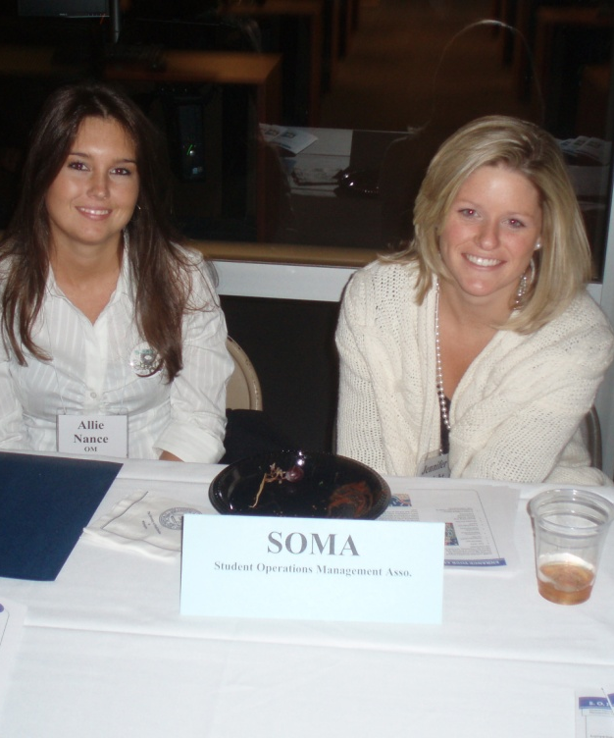
In summary: Attributes of an IS Professional
Business Savvy
Technical Aptitude
Good Communications Skills
It is typical to interact with departments at all levels
Must communicate technical information to managers
Must communicate business needs to technicians
Problem Solvers

Slide 12
IS Graduates Employment data: *2022 Data
75% - had jobs in the field on graduation day
15% - were entering grad school
10% - were still looking
Average Starting Pay
$75,600 – Raleigh/Charlotte, $63,300 - Wilm
70% of graduates had a paid internship
$18+/hour

Slide 13
Internships / Jobs
Ally Bank
Apiture
Castle Branch
Central Square
Credit Suisse
Deloitte
DHG (Security)
Focus Broadband
Fidelity Investments
GE – Hitachi
Google
Live Oak
New Hanover County
Novant Health
MetLife
NC Ports
nCino
P4Technologies
PWC
SageIsland
Velocity Solutions

Slide 14
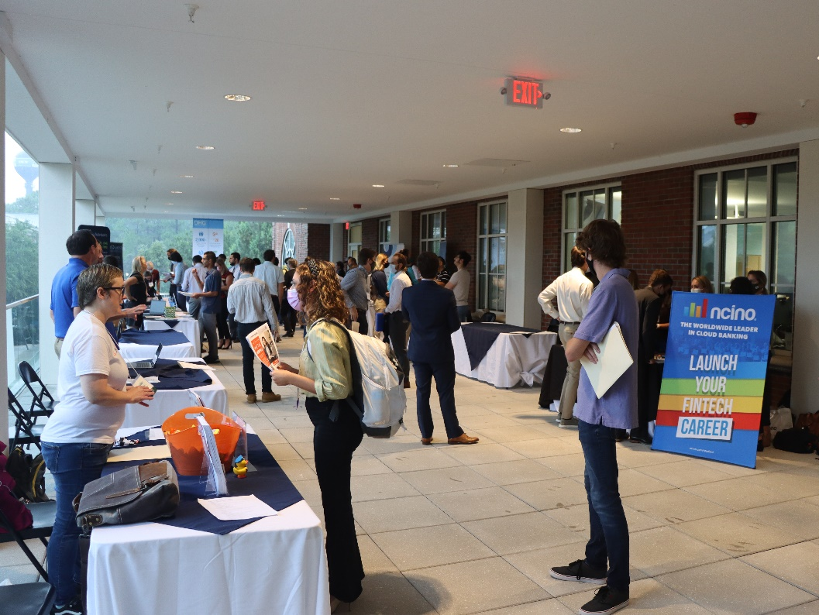
In Summary
IS is a great concentration (or double for ACT, FIN, MKT):
For people who love technology
Want to assist an organization to solve problems
Have a great job opportunity

Slide 15
What should I take next?
MIS 315
Learn more about databases
Useful for all business majors
MIS 310
Web / Device Development
MIS 216
1 credit – Intro to Software Development
Only 6 weeks! Let’s you sample MIS

Slide 16
Questions?
Additional information on the Congdon School website.
To declare IS as your concentration or double you need to complete a form at the CSB Student Services Office.

