Slide 1
AI & Gen AI
A brief overview

Slide 2
About me!
Assistant Professor of Business Analytics
Teach- Predictive Analytics
Research- Applied math models in Operations Management

Slide 3
AI
Traditional AI is not new!
Designed to analyze data and perform specific tasks using predefined algorithms and rules.
Mainly used for:
Predictions
Pattern recognition
Examples: Demand forecasting, Netflix recommendations etc

Slide 4
GenAI
A decade ago- we did not have enough computing power or models.
This is what the world is going gaga over.
Generative AI models are capable of creating new content such as text, images, videos, or code.
Popular examples: ChatGPT-4 (text generation), Dall-E (image generation), Sora (video generation), GPT-4o (multi-modal) among others. These are from OpenAI.
Lots of “big tech” companies are either partnering or making their own GenAI tools.

Slide 5
AGI
Artificial General Intelligence
AI research that attempts to create software with human-level intelligence that can teach itself to adapt

Slide 6
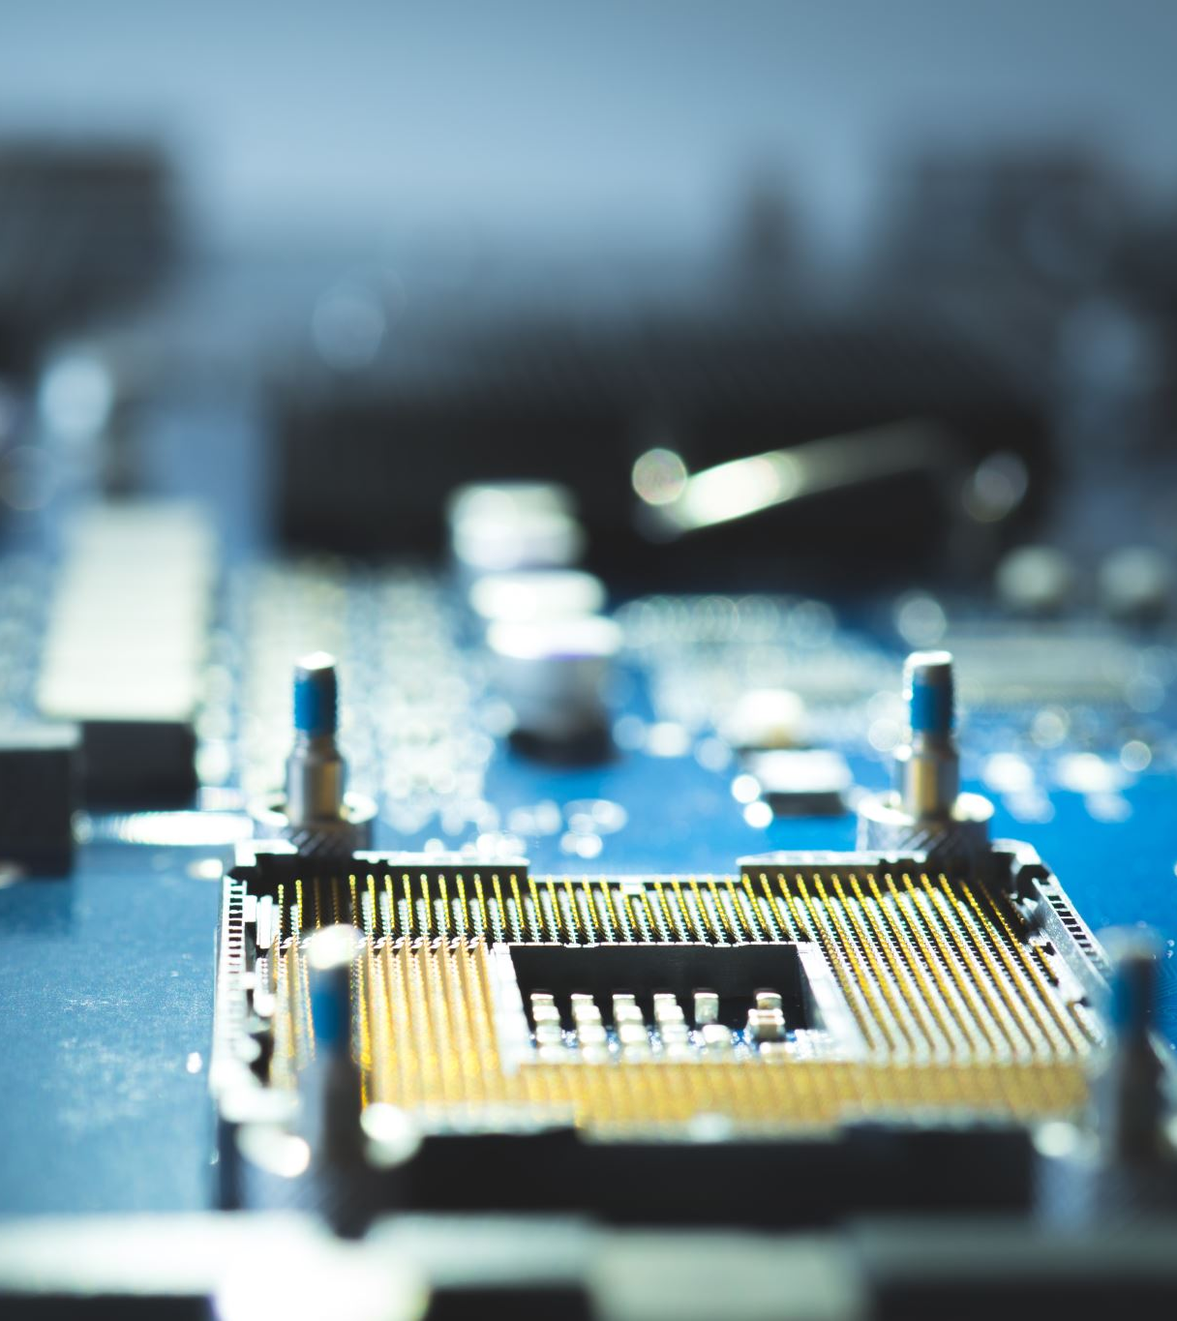
Science vs. Business of AI
Science of AI:
Models that form the bells and whistles
Business of AI:
Tools with GenAI/AI in the background but mainly a UI easy to interact for business use cases

Slide 7
Science of AI
Industry is moving faster than academia
In 2023, 51 notable models are from industry while 15 are from academia.
Best of the models are very expensive with an uncertain return.
For ex: ChatGPT-4 cost estimate is $78 million, whereas Google’s Gemini Ultra is around $191 million
Source: “The AI Index 2024 Annual Report,” Institute for Human-Centered AI, Stanford University

Slide 8
Business of AI
AI was mentioned in 394 earnings calls of the Fortune 500 companies up from 266 in 2022
19.7% of all earnings calls cited GenAI
Funding for GenAI: 8x from 2022 to 2023
AI improves productivity and quality of work
Regulations are on the rise-25 in 2023 vs. 1 in 2016
Source: “The AI Index 2024 Annual Report,” Institute for Human-Centered AI, Stanford University

Slide 9
Big Problem!
As much has been said and done about GenAI, it is hard to trust it 100%.
Most GenAI models that are being used in practice fail at simple logics.
Hallucination is very real with these models.
In the early days, it was worse with people intentionally making the GenAI angry.
Even today there are no standard across the board evaluation metrics for many of these models.

Slide 10
Some use-cases in business disciplines
Marketing
Chatbots or voice agents for customer service
GenAI in digital marketing: making graphics
Accounting
Fraud detection
Finance
Algorithmic stock price prediction, Lending
Supply Chain
Demand Forecasting, Risk Management
Information Systems & Analytics
Copilots for programming

Slide 11
Challenges and Opportunities I faced-teaching
Students that don’t understand anything that GenAI outputs.
With Github copilot and text-based prompting on Google Colab-it is hard to suppress
My thank you notes that I received this semester sound a lot like AI.
Acknowledge and adapt accordingly.
Challenge-Where will this tech be in 2-3 years from now?
Boon or Bane for learning?

Slide 12
Challenges and Opportunities I faced-research
Using GenAI for exercising some of my writing skills (such as sentence framing) got me to write content like GenAI.
As much cooler as it sounds, GenAI still can’t do a lot of quantitative modeling or analysis that researchers do.
Proliferation of articles like we have never seen before.
Acknowledge and adapt accordingly.
Where will this tech be in 2-3 years from now: Could it be writing papers for us?
Boon or Bane for research?

Slide 13
Public reception
People are more concerned than excited about AI
52% in 2023 vs. 37% in 2022
People are nervous towards AI products and services
13% increase from 2022 to 2023
Source: “The AI Index 2024 Annual Report,” Institute for Human-Centered AI, Stanford University

Slide 14
Threat or Opportunity?
There is no denying that
It is already here
It is getting better by the day
Students are using it
Colleagues are using it
Industry is interested in it
In the longer term, we don’t know of
It will just be a tool that improves efficiency
It will take over some/all of our jobs
We must be in the know to see how this shakes out.

Slide 15
Thank you for listening!

