Slide 1
Artificial Intelligence in Research
CSB AI Day|May 14, 2024

Slide 2
Artificial Intelligence in Research
Ophelia Chapman, DBA, MBA, MLIS
Business Librarian
Randall Library

Slide 3
Outline
The ethics debate
Sample tools
Randall Library databases with AI features
Disclosure statements
Use cases
Questions submitted
Considerations for AI use
Access to AI on Campus

Slide 4
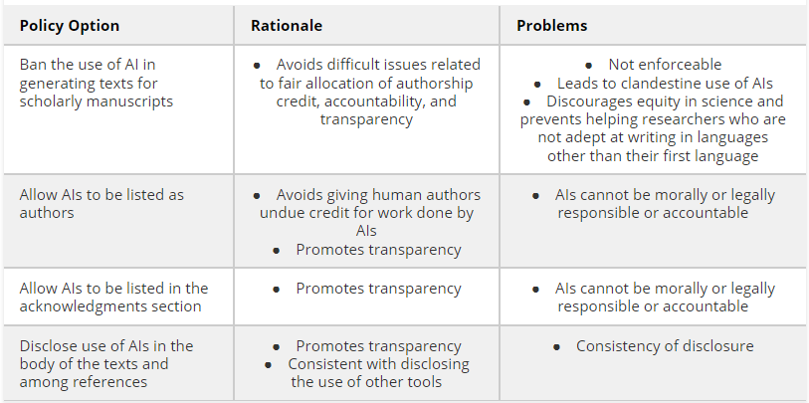
Ethical Debate Considerations
Source: Hosseini, M., Resnik, D. B., & Holmes, K. (2023). The ethics of disclosing the use of artificial intelligence tools in writing scholarly manuscripts. Research Ethics, 19(4), 449-465.

Slide 5
Sample AI tools for the Literature Review Process
AI Tool | Description | How it Leverages ML , NLP , LLM
ChatGPT | A versatile AI tool AI that understands and generates human-like text, supports the research and literature review process by providing insights, summarizing texts, and identifying key themes across a broad spectrum of topics | Uses Natural Language Processing (NLP) to understand and interpret human language, Machine Learning (ML) to learn from vast amounts of data and improve its responses over time, and operates as a Large Language Model (LLM) to generate human-like text based on the learned patterns and information from diverse text sources
Elicit | A research tool that helps users discover, synthesize, and gather insights across academic papers quickly. | Uses NLP to extract structured data from unstructured text and ML to provide relevance-based search results.
Litmaps | A visualization tool that creates dynamic citation maps to track and explore research landscapes. | Employs NLP for smart filtering and topic modeling, and ML to update research maps based on new citations.
Research Rabbit | A research discovery tool that creates a visual map of related work based on a starting paper. | Utilizes ML algorithms to suggest related articles and NLP for semantic analysis to understand document context.
Zotero | A free tool to collect, organize, cite, and share research. | Uses NLP to auto-extract bibliographic information from PDFs, websites, and other digital sources.
Notes:
Efficiently navigate extensive body of literature, Helps discovery and organization, Enhance visualization

Slide 6
AI powered /Features in Lib Databases
Beta testing tool within JSTOR
SCOPUS
EBSCO (Coming soon)
Web of Science ( Sept 2024)
ProQuest Research Assistant (pq1devpartners@clarivate.com)
Get Full Text with LibKey

Slide 7
Keywords Vs Prompts
Comparison Criteria | Keyword Searches in Traditional Library Databases | Prompts in Generative AI Tools
Function | Used to retrieve documents containing specific terms | Used to generate responses or content based on input context
Input Type | Specific words or phrases | Natural language questions or statements
Flexibility | Limited to exact matches or Boolean logic | More flexible, interpreting and responding to complex queries
Results | Direct matches from the indexed content | Creative or synthesized responses based on trained data
User Skill Required | Requires knowledge of search terms and operators | Less reliance on specific syntax, more on natural language

Slide 8
Sample Disclosure Statements in Journals & by Publishers
Journal of Marketing Education
https://us.sagepub.com/en-us/nam/chatgpt-and-generative-ai
Note: Elsevier guidance refers to the use of AI tools in the writing/editorial process, and not to the use of AI tools to analyze and draw insights from data as part of the research process.
Publisher | Publications on ABDC List | Example A-Rated Journal
Elsevier | 228 | Entrepreneurship Theory and Practice
Sage | 191 | Critical Perspectives in Accounting
Wiley | 243 | Journal of Financial Research

Slide 9
Sage: Guidance for authors
Clearly indicate the use of language models in the manuscript, including which model was used and for what purpose. Please use the methods or acknowledgements section, as appropriate.
Verify the accuracy, validity, and appropriateness of the content and any citations generated by language models and correct any errors or inconsistencies.
Provide a list of sources used to generate content and citations, including those generated by language models. Double-check citations to ensure they are accurate and are properly referenced.
Be conscious of the potential for plagiarism where the LLM may have reproduced substantial text from other sources. Check the original sources to be sure you are not plagiarizing someone else’s work.
Acknowledge the limitations of language models in the manuscript, including the potential for bias, errors, and gaps in knowledge.
Please note that AI bots such as ChatGPT should not be listed as an author on your submission.

Slide 10
Wiley best practice guidelines

Slide 11
Committee on Publication Ethics (COPE)

Slide 12
Considerations for Adopting AI
Highest level of transparency
Provide detailed information
Methodologies
Data sources
Updates to their algorithms

Slide 13
When investigating…
FAQ’s
About us/Technology/Our Approach
Documentation and Help Centers
White papers/Technical papers
Webinars and Tutorial Videos
Developer/API Documentation
Terms of Service and Privacy Policy
Research Publications and Conference Proceedings

Slide 14
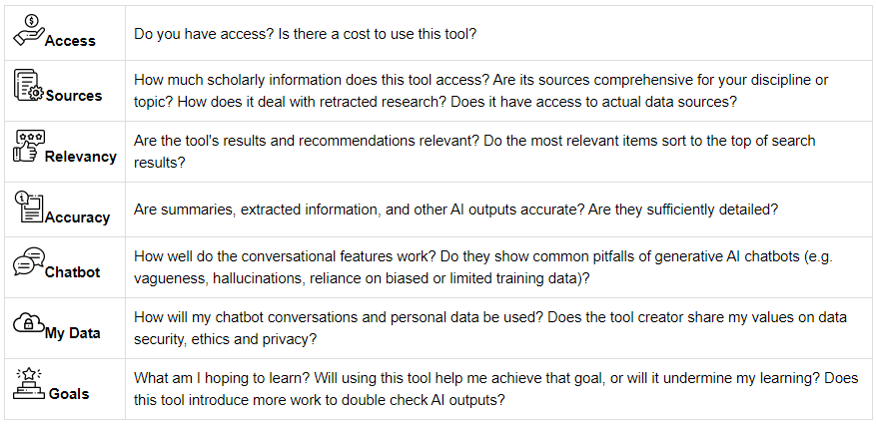
Framework for Assessing Research Tools
Source: Temple University

Slide 15
Research Rabbit: Methodology Search
what finance papers reference quasi-experiment

Slide 16
Elicit: Methodology Search
Research question

Slide 17
Use case in Marketing Education
Explored the significance of generative AI, particularly in the form of ChatGPT, and its potential implications for marketing educators and students. Students=131, Educators 47, follow up = 19
Source: Guha, A., Grewal, D., & Atlas, S. (2024). Generative AI and Marketing Education: What the Future Holds. Journal of Marketing Education, 46(1), 6–17. https://doi-org.liblink.uncw.edu/10.1177/02734753231215436
Benefits | Challenges
Enhances Learning Experiences | Accuracy and Bias
Prepares Students for Future Jobs | Plagiarism Concerns
Promotes Innovation and Creativity | Impact on Critical Thinking
Notes:
Journal of marketing education ABDC: B

Slide 18
Use case in Economics
Idea generation and feedback
Writing
Background research
Data analysis
Coding
Mathematical derivations
Source: Korinek, A. (2023). Generative AI for economic research: Use cases and implications for economists. Journal of Economic Literature, 61(4), 1281-1317.
Notes:
The journal of economic literature, American Economic Association (AEA). A* on ABDC list

Slide 19
Sample ABDC Journals with AI Disclosure Requirements
Journal Title | Subject Area | ABCD Rating | Special Notes on AI Disclosure
Academy of Management Review | Management | A* | Refers to AOM Code of Ethics
Journal of Business Research |  | A | Declaration of generative AI in scientific writing
Decision Support Systems | Information Systems | A* | Disclosure instructions
Journal of Marketing | Marketing | A* | ChatGPT and Generative AI
Accounting, Organizations and Society | Accounting | A* | Disclosure instructions
Journal of Financial Economics | Econ/Finance | A* | Disclosure instructions
Journal of Supply Chain Management | Supply Chain Management | A | Best practices guidelines on research integrity and publishing ethics
Notes:
Decision support systems is published by Elsevier through the ScienceDirect platform
Statement: During the preparation of this work the author(s) used [NAME TOOL / SERVICE] in order to [REASON]. After using this tool/service, the author(s) reviewed and edited the content as needed and take(s) full responsibility for the content of the publication

Slide 20
ITHAKA S+R Tracker
General Purpose
Discovery
Teaching & Learning
Workflow
Writing
Coding
Image Generation
Purchasing model, Description, Key features, Pros, Limitations, Comments, Entry last update
Notes:
Ithaka S+R, works with leaders in higher education, academic libraries, museums, foundations, and publishers to research, evaluate, and provide strategic guidance in a range of areas. Including technology

Slide 21
UNCW AI Resources
Microsoft Copilot
Grammarly (WCE)
Adobe AI Assistant
AI Marketplace for Canvas
High-Performance Computing (HPC) & Research Storage

Slide 22
Want to Explore More…
Article Summaries
TLDRthis*
AskYourPDF
QuillBot
Scholarcy
Summary by OpenAI
ChatPDF
Jenni
Lit Review Drafts
SCISPACE
Jenni AI
Paperpal
Kahubi
Scite
Finding Research Gaps
Powerdrill
QuillBot
Connected Paper
OATD*
R Discovery*
* Free
Notes:
Add coding category Github

Slide 23
Want to Explore More… Cont’d
Coding Tools
Github Copilot
Phind
Writing
Wordvice AI*
Jenni
QuillBot
Curie
Web scrapping
Distill.io
AI Content Detector
QuillBot *
Undetectable AI
* Free
Notes:
Add coding category Github….. Work on this!!!!!!

Slide 24
Papers Listing AI Tools Used
Heucher, K., Alt, E., Soderstrom, S., Scully, M., & Glavas, A. (2024). Catalyzing Action on Social and Environmental Challenges: An Integrative Review of Insider Social Change Agents. Academy of Management Annals, 18(1), 295–347. https://doi-org.liblink.uncw.edu/10.5465/annals.2022.0205
Siderska, J., Aunimo, L., Süße, T., Stamm, J. von, Kedziora, D., & Aini, S. N. B. M. (2023). Towards Intelligent Automation (IA): Literature Review on the Evolution of Robotic Process Automation (RPA), its Challenges, and Future Trends. Engineering Management in Production & Services, 15(4), 90–103. https://doi-org.liblink.uncw.edu/10.2478/emj-2023-0030
White, G. R. T., Samuel, A., Jones, P., Madhavan, N., Afolayan, A., Abdullah, A., & Kaushik, T. (2024). Mapping the ethic‐theoretical foundations of artificial intelligence research. Thunderbird International Business Review, 66(2), 171–183. https://doi-org.liblink.uncw.edu/10.1002/tie.22368

Slide 25
Questions?
Thank you
Ophelia Chapman
chapmano@uncw.edu
Schedule a consultation

Slide 26
Artificial Intelligence, Copyright, and Scholarly Publishing An Overview
Anne Gilliland, MLS, JD
Scholarly Communications Officer
agilliland@unc.edu

Slide 27
Mad Dash Through Copyright
Protects creative expression fixed in a tangible medium
Lasts a long time
The rights holder has a near-monopoly on the bundle of rights during the copyright term
The rights holder must be a “natural person”
Copyright exceptions bring balance and help copyright work with the constitution
Fair use is a flexible exception that can be invoked for purposes that society thinks are desirable

Slide 28
Many Creators, Many Creations
Many copyrighted works and many rights holders
Model is trained on a corpus of work
These works may be in copyright
Individuals and companies may have created compilations during assembly of data sets and training models
These are not one-time processes
Person who enters a prompt may own a copyright in the prompt or may enter someone else’s copyrighted work
Some systems search the internet in real time when queried
And add more copyrighted content to the mix

Slide 29
Points of Potential Copyright Ownership & Infringement
Initial data may be copyrighted
Some training sets seem to include misappropriated content
Training datasets may be copyrighted as compilations
Base models and aligned models
Derivative works or curated compilations
Display services and platforms may implicate rights of public display and performance
Who owns generated content: end user, companies, all previous rights holders?
AI litigation database

Slide 30
Attribution
Not automatically required in US copyright law
Problem for assessing reliability and infringement
Plagiarism concerns for universities and publishing
Hard or impossible to trace the exact origin of a generative product
Size of datasets
Lack of attribution in the data itself
Chain of similarity can be hard to trace

Slide 31
Substantial Similarity
Copyright infringement requires substantial similarity and the opportunity to copy
Some plaintiffs have been able to prove that there was reproduction of their work
Substantial similarity of the generative output and the original is harder to establish
To what degree does © protect a creator’s style?
Name and likeness reproduction and voice simulation/cloning may not violate copyright
May implicate rights of publicity

Slide 32
Does AI Training Data Infringe Copyright?
Several court cases pending where writers and artists assert that using their works as training data is infringement.
In U.S., there is some chance that this is fair use in some circumstances
Other cases about “non-consumptive uses”
HaitiTrust & Google Books both found fair use in similar circumstances
Multiple countries, including US, are considering laws that would
Require transparency (what was used for training)
And compensation
In the EU, rights holders must overtly signal that material should not be used for training

Slide 33
Can AI-Generated Works Have a Copyright?
U.S., and most other countries, say no
Human authorship is required, according to U.S. courts & Copyright Office (so far)
Thaler v. Perlmutter (2023) District court affirmed CO denial of copyright for AI-generated image.
Naruda v. Slater (2018) Ninth circuit ruled that monkey (Naruda) could not hold copyright.

Slide 34
What we are seeing on campus
At UNC
AI guidelines for teaching and student work
Faculty question how to apply them
How to assess plagiarism
Enterprise version of Microsoft Co-Pilot
Questions from instructional designers
Voice cloning, contracts, ethics
Biomed faculty
Reliability, provenance, attribution
Use of specialized models
Technology transfer issues
Data ownership
Requests for datasets

Slide 35
Library Electronic Resources and AI
UNC and others negotiating with major publishers about the use of their licensed content with AI tools
International Consortium of Library Consortia has issued ICOLC Statement on AI in Licensing
Model language for negotiations—Rachael Samberg, Timothy Vollmer, & Samantha Teremi, Fair Use Rights to Conduct Text and Data Mining…
My March 2024 Copyright Committee report to the UNC Faculty Council discusses our licensing issues

Slide 36
Copyright Office Plans for AI Policy & Guidance
Zarya of the Dawn, created with Midjourney

Slide 37
New Laws: Rights of Publicity and AI
States are strengthening rights of publicity
Adding voice rights
Rights continue after death
Adding circumstances where the rights apply
Tennessee passes ELVIS Act (Ensuring Likeness, Voice, and Image Security Act of 2024)
California and other states will probably pass similar statutes

Slide 38
Recommended Reading
The Atlantic’s AI Coverage (paywalled)
U.S. Copyright Office, Copyright and Artificial Intelligence
James Grimmelmann, Katherine Lee & Feder Cooper, Talkin’ About My AI Generation, Journal of the Copyright Society of the U.S., 2024 (forthcoming)
Matthew Sag, Copyright Safety for Generative AI, Houston Law Review, 2023.
Jennifer Rothman, Rothman’s Roadmap to the Right of Publicity

Slide 39
Available Funding Sources for Artificial Intelligence
Michael Smith, Ed.D, M.Ed
Director, Institutional Research & Analytics
smithmj@uncw.edu

Slide 40
Objectives
Summary of Current Funding Sources: Public and Private
Adoption by Business Function
Generative AI Forecast
AI Preparedness Index
Specific Funding Opportunity
Anecdotal Funding Opportunities
External and Internal Resources

Slide 41
Summary of Current Funding
Public
National Science Foundation (NSF)
$700 Million annual investment in AI-related areas (research, application, education/workforce development).
Funding Search Tool
NSF National AI Research Institutes
25 AI Institutes partnering with 500+ institutions (US and Global)
Theme 1: AI for Astronomical Sciences
Theme 2: AI for Discovery in Materials Research
Theme 3: Strengthening AI
PAPPG Details (lengthy)
Notes:
NSF is making significant investments in AI related activities including research, practical applications, education and workforce development on a national level.
Within NSF Funding Search Tool, there is the ability to narrow down searches by level of interest. For example if desired activity is focused on graduate-level, or post-doc level research these can be identified and targeted.
Currently, there are only 25 AI Institutes within the US. From a quick review, most of these seem to be R1 universities. Right now there is not a call of additional AI research institutes but there will be more information available within their webpage. Prior proposal requirements include the development of partnerships, this context can help to explain the 500+ partnerships stemming from these institutes.

Slide 42
NSF National AI Research Institutes and Awards
Notes:
https://www.nsf.gov/awardsearch/advancedSearchResult?ProgEleCode=132Y00&BooleanElement=Any&BooleanRef=Any&ActiveAwards=true#results
Within the research institute site, there is the ability to search by type of award. Highlighted is the state of North Carolina, which holds two current awards one at NC State and the other at Duke.
You can also search by the NSF "Organization" meaning the topical focus of the award and also get a sense of the award amount. Currently a majority of awards are over $1M.

Slide 43
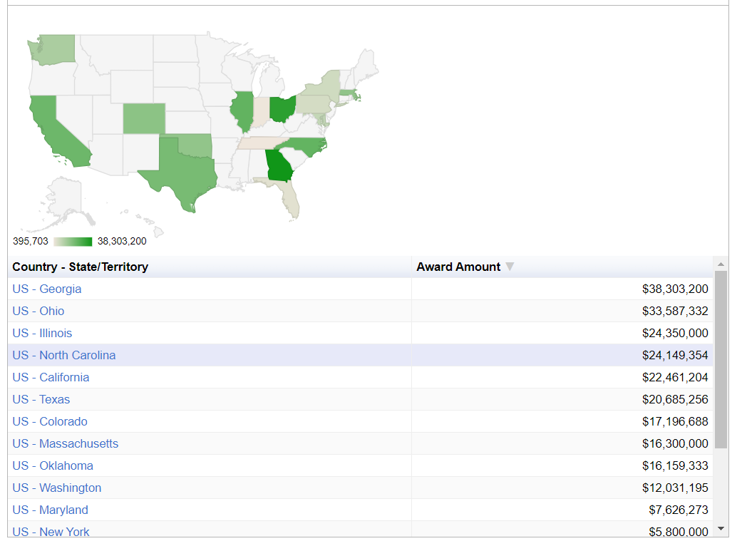
NSF National AI Research Institutes and Award Levels
Source: NSF Awardsearch
Notes:
https://www.nsf.gov/awardsearch/advancedSearchResult?ProgEleCode=132Y00&BooleanElement=Any&BooleanRef=Any&ActiveAwards=true#results
This is another view of awards by State. Currently North Carolina ranks 4th in the total award amount with $24M.

Slide 44
Summary of Current Funding
Private (Between 2018 – 2023)
Over $267 Billion raised
4,483 companies ($263 B)
Over 9,000 funding rounds
Stated Project Themes
Corporate Projects with goals of benefitting humanity.
Academic projects with goals of advancing knowledge.
Small private companies with various goals or unknown.
Notes:
There has been a significant amount of capitol raised over the past 5+ years in the private sector. These funds are distributed to a number of companies, with about 4.5K holding most of the funds. While we do not know the focus of all of these projects, here are some of the themes of current known projects.

Slide 45
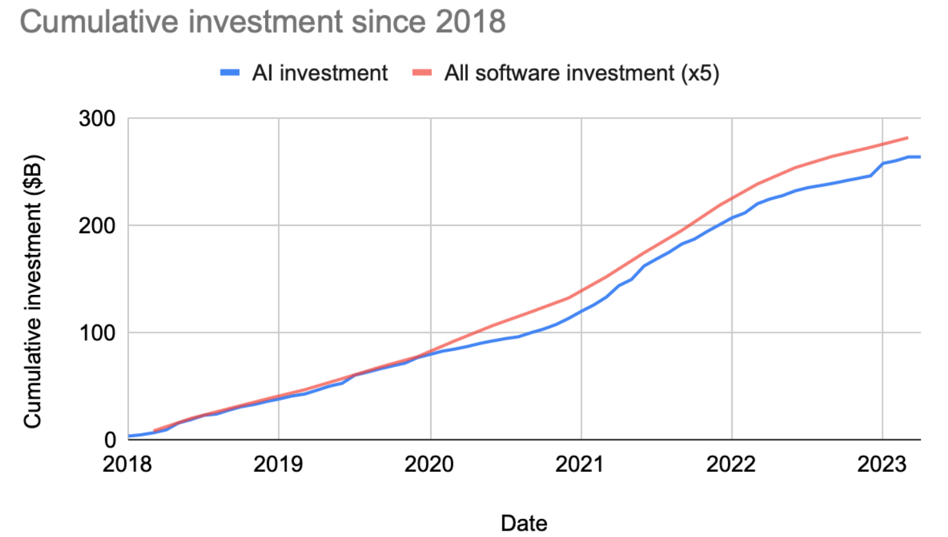
AI Funds Raised (Cumulative)
Source: Crunchbase
Notes:
Cumulatively since 2018, you can notice that a significant amount of software investment has been in the AI space.

Slide 46
AI Funds Raised (Monthly)
Source: Crunchbase
Notes:
Large funding spike in 2023 is due to Microsoft’s investment in OpenAI. This was the largest investment ever in an AI company and third largest investment ever in any software company.
Investment in AI and other software is likely

Slide 47
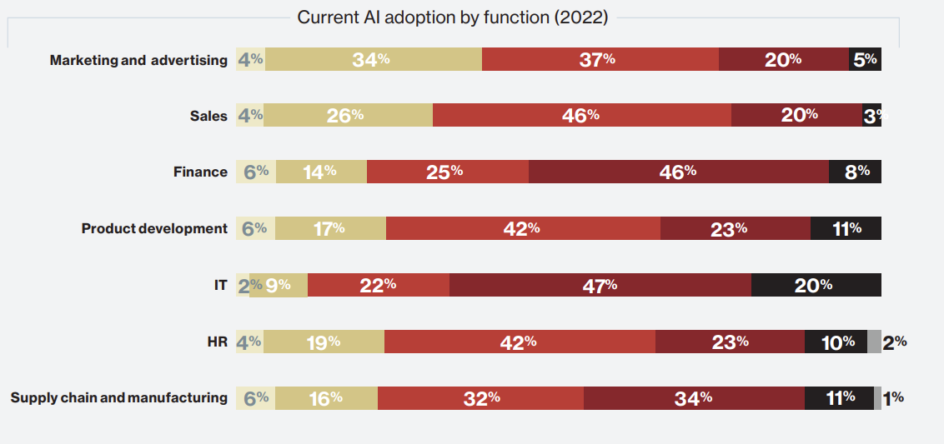
Generative AI Adoption by Business Function
Notes:
https://www.databricks.com/sites/default/files/2023-07/ebook_mit-cio-generative-ai-report.pdf

Slide 48
Generative AI Forecast

Slide 49
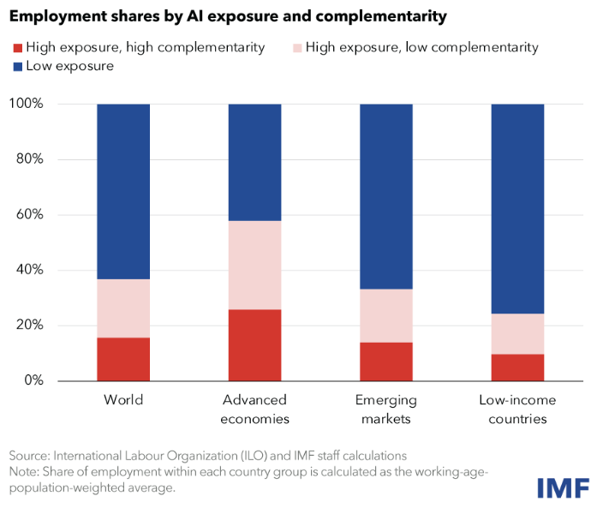
Economic Climate Impact on AI

Slide 50
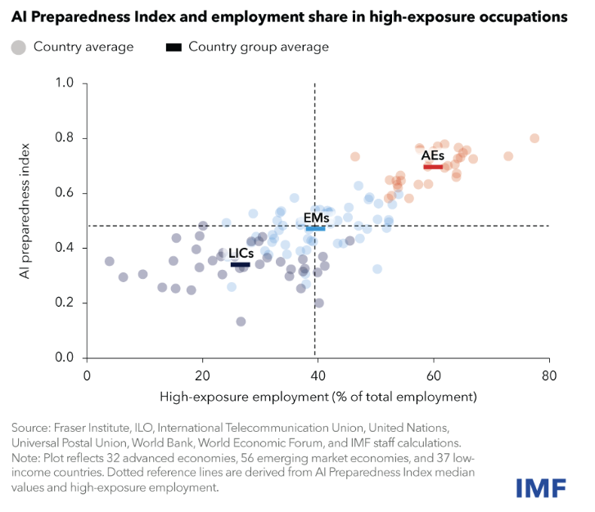
AI Preparedness Index
Implications
40 Percent of Global employment is exposed to AI in some manner.
Advanced Economies (AE) face both greater risks and benefits from AI adoption/integration.
60% of jobs in AE maybe impacted by AI.
Notes:
AI Preparedness Index is produced by the International Monetary Fund (IMF) for the purposes of measuring readiness in areas such as digital infrastructure, human capital, labor market policies, innovation and economic integration, and regulation and ethics.
IMF assessed the readiness of 125 countries, and unsurprisingly found that wealthier economies tend to be better equipped for AI adoption than low-income countries (though there is considerable variation across countries).
Singapore, United States, and Denmark posted the highest scores on the index based on their strength across each of the four categories tracked.
AE: Advanced Economies
EM: Emerging Markets
LIC: Low Income Countries
When I look at this index, there are a few things that come to mind:
Advanced economic countries are likely to experience a significant shift in their labor markets. These labor markets maybe more prepared for the shift/disruption of AI, thus would require fewer resources or support given their situation. While there will be many opportunities within AE, there will also be significant risks and potential pushback for markets that tend to be a little more risk averse.

Slide 51
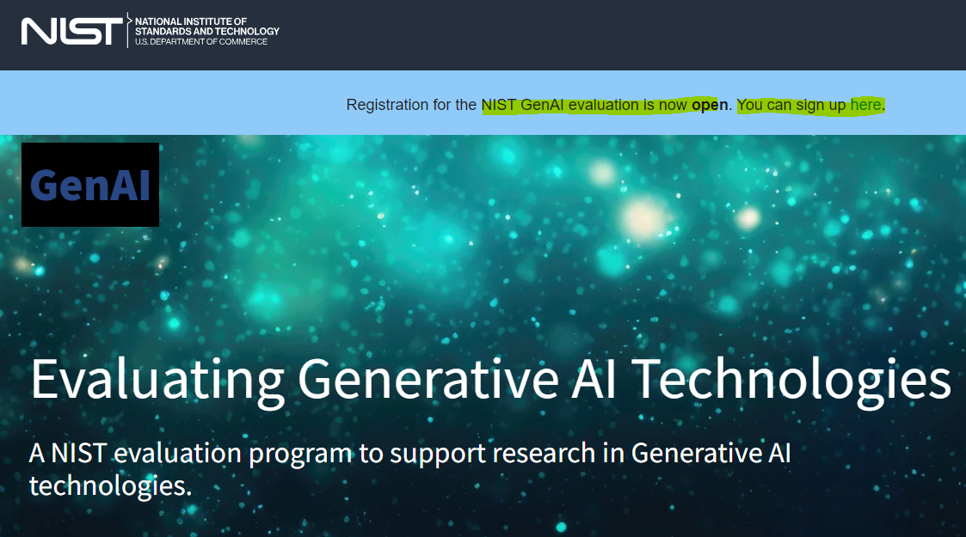
NIST GenAI Pilot
Pilot Study aimed at measuring and understanding system behavior.
Discriminating between synthetic and human-generated content.
April 2024: GenAI Pilot Launch
May 2024: Registration Period Open
August 2024: Round 1 Submission Deadline
Notes:
https://ai-challenges.nist.gov/genai

Slide 52
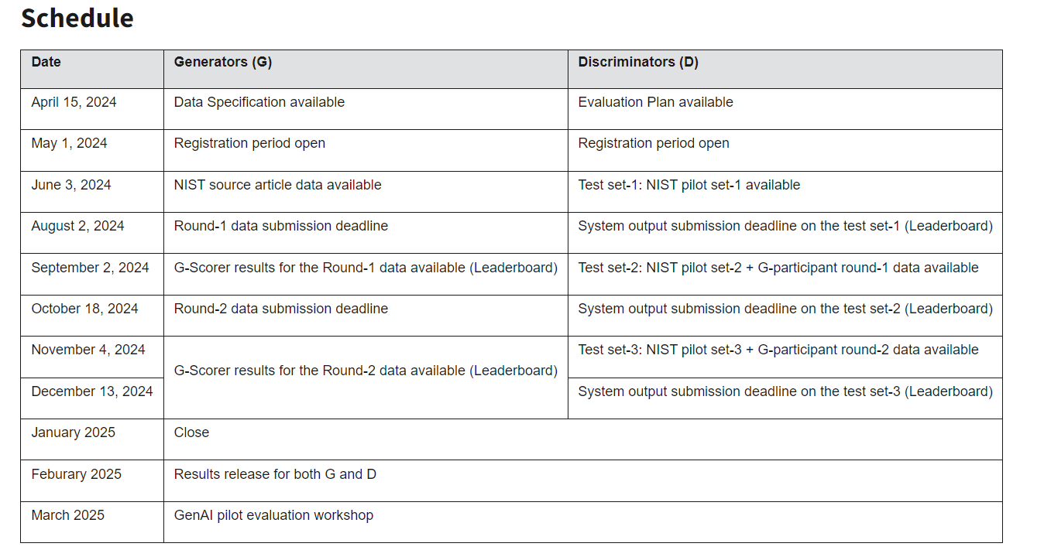
NIST GenAI Pilot Timeline
Notes:
https://ai-challenges.nist.gov/genai
The pilot study aims to measure and understand system behavior for discriminating between synthetic and human-generated content in the text-to-text (T2T) and text-to-image (T2I) modalities. This pilot addresses the research question of how human content differs from synthetic content, and how the evaluation findings can guide users in differentiating between the two. The generator task creates high-quality outputs while the discriminator task detects if a target output was generated by AI models or humans.
Generator teams will be tested on their system's ability to generate synthetic content that is indistinguishable from human-produced content.
Discriminator teams will be tested on their system's ability to detect synthetic content created by large language models (LLMs) and generative AI models.

Slide 53
Anecdotal Funding Opportunity
https://sparq.stanford.edu/
Notes:
Hetey, R. C., Hamedani, M. G., Markus, H. R., & Eberhardt, J. L. (2024). “When the Cruiser Lights Come On”: Using the Science of Bias & Culture to Combat Racial Disparities in Policing. Dædalus, 153(1), 123-150.
Drs. Jennifer Eberhardt and Hazel Markus developed an action-based think-tank (Do tank) at Standford called SPARQ (or Social Psychological Answers to Real-World Questions). SPARQ, formed in 2011, receives funding from a number of different funders, including: MacArthur Foundation, Robert Wood Johnson Foundation, Bill & Melinda Gates Foundation, Urban Institute, Frudential, Russell Sage Foundation, and Stanford internal funding.
In this example, Dr. Eberhardt developed a partnership with the Oakland California Police Department. This mutually beneficial partnership included allowing social psychologists the ability to access body camera footage of police officers during routine traffic stops (just the audio to protect police officers and those being stopped). The researchers leveraged Large Language Modeling AI technology to churn through 1,000 traffic stops.

Slide 54
External Resources
NSF/NAIAC
Recommendation: StatewideRepositories
Recommendation: Harnessing AI for Scientific Progress
Recommendation: Reporting Use of High-Risk AI
Finding: Positive Impact on Science and Medicine
Recommendation: AI for Scientific Progress
Findings and Recommendation: AI Safety
NSF AI Institutes
NSF Funding Search
Government Use of AI
Additional Resources
Computing Community Consortium
American Association for the Advancement of Science
City of Boston AI Guidelines
Stanford SPARQ

Slide 55
Internal Resources
Research and Innovation:
SPIN (Funding Opportunity Search Database)
Internal Funding Opportunities
Research Momentum Fund
Translational Research Grants
Interdisciplinary Research Seminar Series
Contact: Research@uncw.edu

Slide 56
Questions?

