Slide 1
CSB Presents: Exploring AI (aka: AI Day)
Coordinators
Judith Gebauer
Kevin Matthews (MC)
Support Staff
Shalin Hale
Madison Rasnake
Megan Canny
Donna Kurtz
Amy Ormon

Slide 2
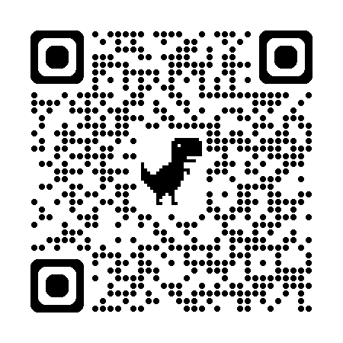
AI Day Agenda
8:30 | Breakfast
9:00 | Welcome | Robert Burrus, CSB Dean
9:10 | Overview | Kevin Matthews, IS
9:30 | AI - What is it? | Avinash Geda, BAN Curry Guinn, CS Parker Moran, Director Networking, ITS
10:30 | AI in Teaching | Lance Cummings, English Dept Anastasia Kuz-Grady, Ed Developer, Ctr Teaching Excel Zachary Morgan, Deel
11:30 | Open Forum - AI in Teaching | Kevin Matthews, IS
Noon | Lunch
1:00 | AI in Research | Ophelia Chapman, Business Libarian, Randall Anne Gilliland, Scholarly Comm Officer, Univ Libraries, UNC Michael Smith, Dir Instutional Research & Analytics
2:00 | Light refreshments and transition to Breakout Rooms
2:15 | Breakout Sessions AI in Practice | Various speakers and locations
3:15 | Open Forum – Where Do We Go From Here | Kevin Matthews, IS
https://csbapp.uncw.edu/csb_ai/
Notes:
All session are in CH 105 except the Breakout Sessions at 2:15
Main topic areas:
AI in general
Using AI in teaching
Using AI in research
Using AI in practice
Attendance sheets will be passed around at the 9:30, 10:30, 1:00, and 2:15 sessions
Write your name in if missing from RSVP attendance sheet
$250 for morning, $250 for afternoon
Pay will come as FLAC for June paycheck

Slide 3
Open Forum – AI in Teaching
ONE thing you’re already doing?
ONE thing you plan to explore/implement?
Any lingering thoughts to share?
Notes:
What is 1 thing that you’re already doing that you feel others should be doing, too?
What is 1 thing that you heard about today that you plan to implement/explore?
Do you have any lingering thoughts that you want to share with the group?

Slide 4
AI Day Agenda
8:30 | Breakfast
9:00 | Welcome | Robert Burrus, CSB Dean
9:10 | Overview | Kevin Matthews, IS
9:30 | AI - What is it? | Avinash Geda, BAN Curry Guinn, CS Parker Moran, Director Networking, ITS
10:30 | AI in Teaching | Lance Cummings, English Dept Anastasia Kuz-Grady, Ed Developer, Ctr Teaching Excel Zachary Morgan, Deel
11:30 | Open Forum - AI in Teaching | Kevin Matthews, IS
Noon | Lunch
1:00 | AI in Research | Ophelia Chapman, Business Libarian, Randall Anne Gilliland, Scholarly Comm Officer, Univ Libraries, UNC Michael Smith, Dir Instutional Research & Analytics
2:00 | Light refreshments and transition to Breakout Rooms
2:15 | Breakout Sessions AI in Practice | Various speakers and locations
3:15 | Open Forum – Where Do We Go From Here | Kevin Matthews, IS
https://csbapp.uncw.edu/csb_ai/

Slide 5
AI Day Breakout Sessions
Accounting
CH 135 | John Hartman, Managing Director, Deloitte Stephanie Jarvis, Director, FORVIS George Marriott, Sr. Product Mgr, BDO (virtual)
Cybersecurity
CH 132 | Jeff Greer, Cybersecurity Geoff Stoker, Cybersecurity
Finance/Banking
CH 133 | Justin Norwood, CPO, Cascading AI
HR/Project Mgmt/Entrepreneurship
CH 111 | Paul Carney, SPHR, Perpeta Scott Kelly, Dir of Entrepreneurship, Campbell University (virtual) Adam McCombs, CPO, Vantaca
IS/BAN/Logistics
CH 101 | John Gillespie, CTO, Megacorp Logistics Shawn Knowles, Sr Director of IT, ThermoFisher/PPD Albert Steed, CEO, True IP Solutions
Sales/Marketing/CRM
CH 123 | Stefanie Boyer, Chief Science Officer, Bryant University Daniel Khorram, Account Exec Fin Services, Salesforce (virtual)
Notes:
Refreshments in lobby
Please meet back at 3:15 in CH 105 for wrap up discussion

Slide 6
Open Forum – AI in Research/Practice
ONE thing you’re already doing?
ONE thing you plan to explore/implement?
Takeaways from Breakout Sessions?
Any lingering thoughts to share?
Notes:
What is 1 thing that you’re already doing that you feel others should be doing, too?
What is 1 thing that you heard about today that you plan to implement/explore?
What is being done in practice?
What expectations should we have for our graduating students in terms of AI literacy?
Do you have any lingering thoughts that you want to share with the group?

Slide 7
Where Do We Go From Here?
Your perspective/outlook on AI
CSB Summer AI Taskforce
Chair: Judith Gebauer
If interested, contact your department chair
Notes:
Has your perspective/outlook on AI and how it relates to our jobs changed today? How so?
What do you believe the AI task force should consider or focus on?

