Slide 1
AI-Informed Assignment Design
Presented by: Zach Morgan, Senior Instructional Designer
Office of Distance Education and eLearning

Slide 2
Mini-Session Goals
Explore a workflow for intentional revisions
Identify considerations for each step
Connect with tools, resources, and services

Slide 3
Assumptions
Familiarity with GenAI tools
Rapidly evolving space
Assignments change over time
Thoughtful design takes time*
*But maybe not as much as we think

Slide 4
Phases of Design
1) Analyze
2) Plan
3) Build
4) Refine

Slide 5
Sample Workflow
Analyze: Forget AI (for now)
Analyze: Select Assignment
Analyze: Break it down
Plan: Select Strategies & Tools
Build: Re-assemble
Build: Communicate Expectations
Refine: Test/Revise
Refine: Pilot/Iterate

Slide 6
Forget AI (for now)
Many Reasons to Revise:
Alignment
Age of assignment
Currency/Relevance
High-stakes
Pain points
Knowledge gaps
Feedback
Motivation
Engagement
New teaching strategies
New tools
Variety
Workload

Slide 7
Factors that influence cheating
Relevance
Clarity
Digital Literacy
Community
Preparedness
High-stakes
Ease of cheating

Slide 8
Phase 1: Analyze
Do:
Consider:
Forget AI (for now)
Select Assignment(s)
Prioritize
Clarify purpose
Break it down
Cognitive steps
Submission steps
For each assignment step:
How can AI help?
How might it hinder?
Using/updating a design map

Slide 9
Example – Original Assignment
Course Objective | Activity | Assignments | Instructional Materials
Create a comprehensive business plan… …for a startup or an existing business, addressing market analysis, financial projections, risk management, and growth strategies. | Case Study Analysis and Discussion | Prepare a risk management plan Ethical Considerations Reflection | Textbook chapters on risk management and ethical considerations

Slide 10
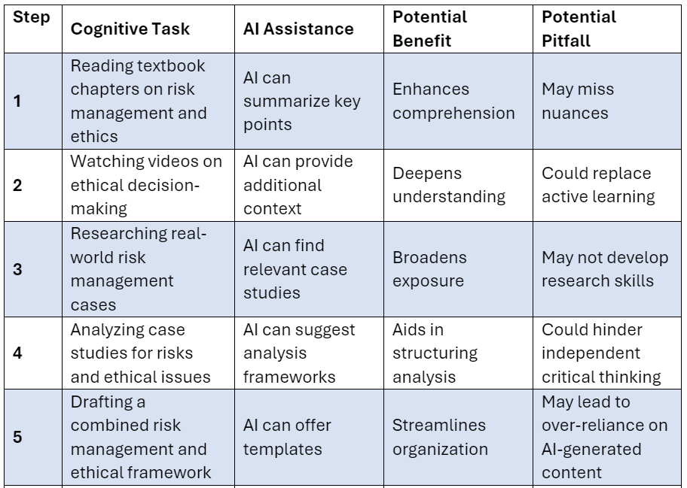
Example – Breaking it down

Slide 11
Phase 2) Plan
Do:
Consider:
Three Options for revision:
Match Strategies to steps
Start from scratch
Use a template
Instructional design consultation
🤖 Ask AI for options

Slide 12
Possible Strategies
Scaffolding assignments
Critiquing AI Responses
1-1 Meetings / Debriefs
Expecting More
AI Literacy Activities
AI Practice Activities & Feedback
Local, unique, personal (Bowen & Watson, 2024)
AI as Team Support
Turnitin / Proctoring Software
Creating & Curating Materials

Slide 13
Example – Matching tasks & Strategies
Tasks (Risk Plan & Ethics): | Reading textbook chapters | Drafting Risk Plan | Video or in-class justification and reflection
Strategies: | Indicate page numbers Replace ethics chapter with mini-lecture video Video reflection “exit ticket” Cite textbook in risk plan | Given previous work, use AI to brainstorm risks Prompt should show context of student project Critique AI risk plan and revise Enter revised risks into risk template | Process walkthrough / justifying priorities Reflection on pros/cons of AI response
Notes:
\

Slide 14
Phase 3: Build
Do:
Consider:
Clearly articulate in writing:
Purpose
Steps
Tools
Expectations
Support
Update global expectations as needed
Designing on paper first
Assignment walkthrough (live or video)
🤖 AI assistance with drafting instructions, rubrics, templates

Slide 15
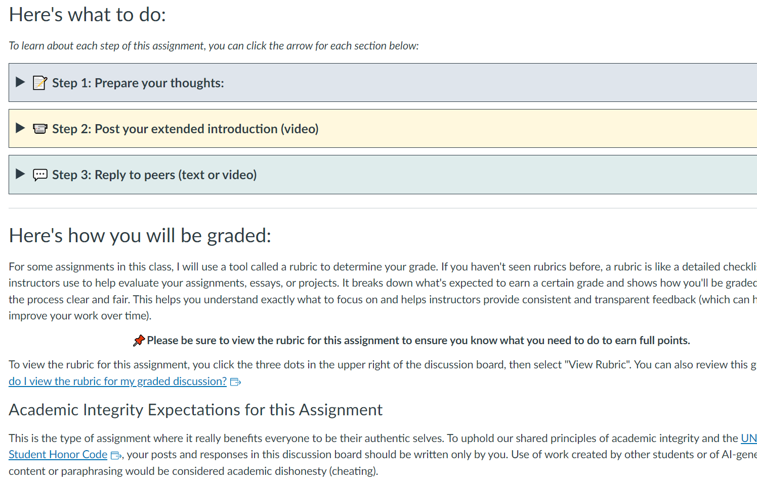
Example

Slide 16
Phase 4: Refine
Do:
Consider:
Test before launch, refine after pilot
Document the process
Expect revisions
Brief “exit ticket” survey
Multiple feedback channels:
Colleagues
DEeL
Former students
Grad students
🤖 AI tools

Slide 17
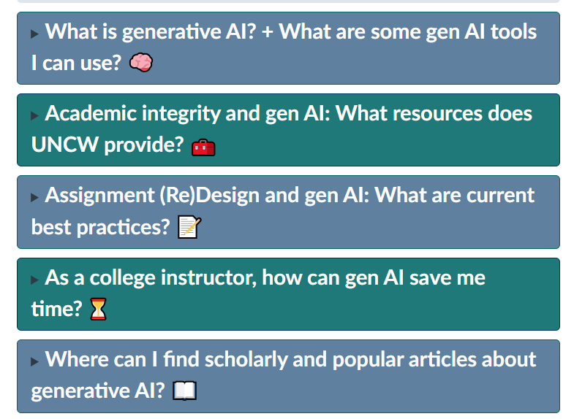
Support: Online, Hybrid, Web-enhanced
DEeL Tutorial Portal
Instructional Design Consultations
Microsoft Copilot
LinkedIn Learning
Respondus Lockdown Browser/Monitor, Turnitin
Screenshot: AI Resources in DEeL Tutorial Portal

