Slide 1
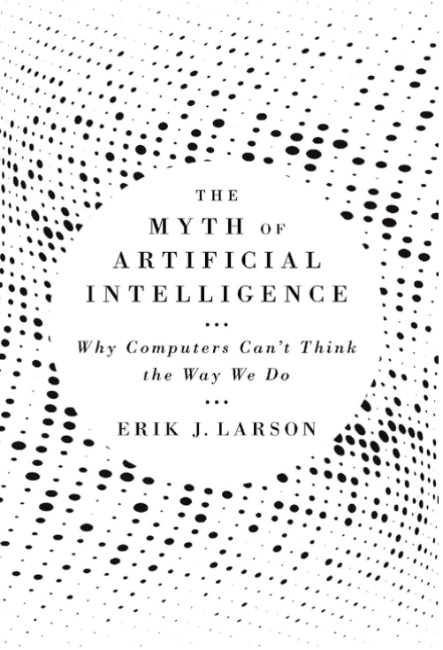
CYBR – CSB AI Day
The Myth of AI
NLP
Word2Vec
demo
ML
Classification (e.g., spam?)
Used
Vocab quizzes
CVE classification

Slide 2
Classifier Pitfall
1 in 1000 people have a certain predisposition to a deadly disease for which a daily pill will prevent it from activating.
There is a test that is 95% accurate for diagnosing the predisposition.
Imagine that you are tested and receive a positive result notification – what is the likelihood that you actually have the predisposition?

Slide 3
1 in 1000 – 95% accurate…
TP/FP and TN/FN?
1 / 49 – 950 / 0

Slide 4
Used
Vocab quizzes
MIS 213 (557 terms) and MIS 365 (442)
Distractor selection
MSCSIS Capstone
~3% of published CVEs are exploited in the wild
Use CISA KEV
Classifier based on select CVE fields

Slide 5
Cosine Similarity
https://www.omnicalculator.com/math/cosine-similarity
a = [-0.4, 0.8] and b = [-0.3, 0.2]
a.b = (-0.4)(-0.3) + (0.8)(0.2) = 0.28
||a|| = [(-0.4)² + (0.8)²]^{.5} = 0.8944
||b|| = [(-0.3)² + (0.2)²]^{.5} = 0.3606
a.b = 0.28 / (0.8944 * 0.3606)
a.b = .8682

