Slide 1
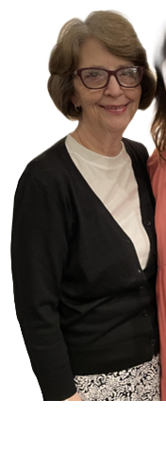
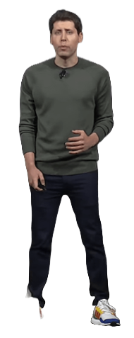

Slide 2
Question
When have you assigned students to use AI?
Notes:
Helping communities and individuals through….here’s why invest and here’s why we need to connect disadvantaged…Social Impact
4/1
Beginning – how bad things are in rural areas and in the middle are steps that make it possible
Two Americas – Rural and Urban, We can let collapse, America is about individual taking care of their lives, rural America is missing access to ecosystems/infrastructure that enables e-ship
Growth in small biz
Then…paint picture of disadvantaged….access to capital/networks, vision, lack of motivation/role models

Slide 3
Question
Who has engaged in dialogue with a LLM via voice function?
Notes:
Helping communities and individuals through….here’s why invest and here’s why we need to connect disadvantaged…Social Impact
4/1
Beginning – how bad things are in rural areas and in the middle are steps that make it possible
Two Americas – Rural and Urban, We can let collapse, America is about individual taking care of their lives, rural America is missing access to ecosystems/infrastructure that enables e-ship
Growth in small biz
Then…paint picture of disadvantaged….access to capital/networks, vision, lack of motivation/role models

Slide 4
Question
Created your own GPT?
Notes:
Helping communities and individuals through….here’s why invest and here’s why we need to connect disadvantaged…Social Impact
4/1
Beginning – how bad things are in rural areas and in the middle are steps that make it possible
Two Americas – Rural and Urban, We can let collapse, America is about individual taking care of their lives, rural America is missing access to ecosystems/infrastructure that enables e-ship
Growth in small biz
Then…paint picture of disadvantaged….access to capital/networks, vision, lack of motivation/role models

Slide 5
Question
Attempting to get students
GPT-4 so they can
create custom GPTs?
Notes:
Helping communities and individuals through….here’s why invest and here’s why we need to connect disadvantaged…Social Impact
4/1
Beginning – how bad things are in rural areas and in the middle are steps that make it possible
Two Americas – Rural and Urban, We can let collapse, America is about individual taking care of their lives, rural America is missing access to ecosystems/infrastructure that enables e-ship
Growth in small biz
Then…paint picture of disadvantaged….access to capital/networks, vision, lack of motivation/role models

Slide 6
Question
Attempting to get students
GPT-4 so they can
create custom GPTs?
Notes:
Helping communities and individuals through….here’s why invest and here’s why we need to connect disadvantaged…Social Impact
4/1
Beginning – how bad things are in rural areas and in the middle are steps that make it possible
Two Americas – Rural and Urban, We can let collapse, America is about individual taking care of their lives, rural America is missing access to ecosystems/infrastructure that enables e-ship
Growth in small biz
Then…paint picture of disadvantaged….access to capital/networks, vision, lack of motivation/role models

Slide 7
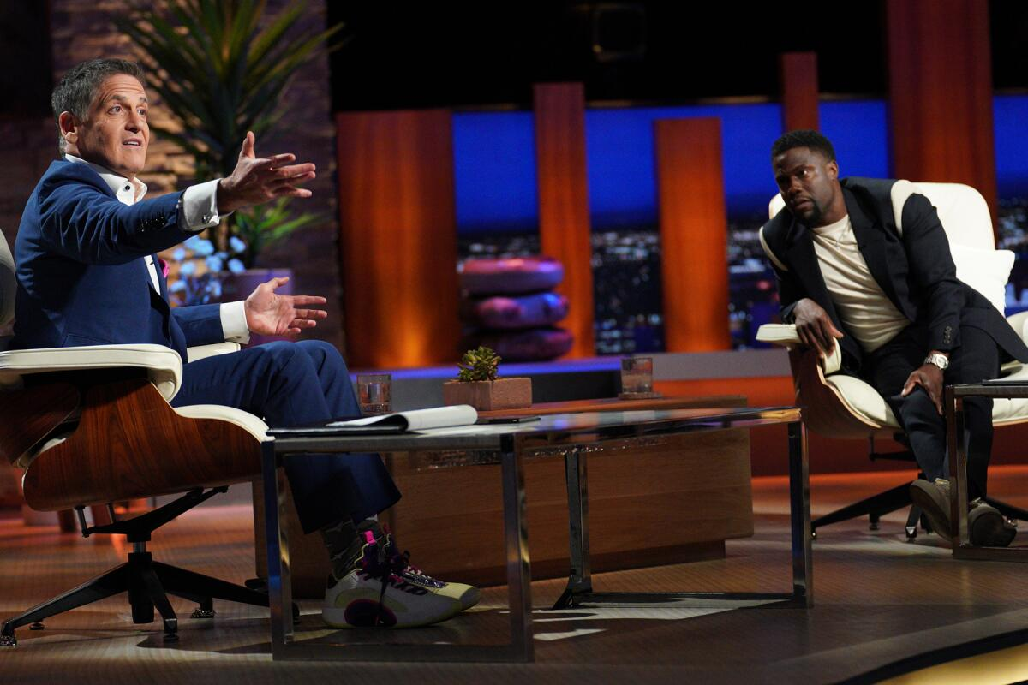
Assignment Examples
Notes:
My hope is that this is a brainstorm session and that you have actionable take aways.
Get feedback on your pitch from Mark Cuban

Slide 8
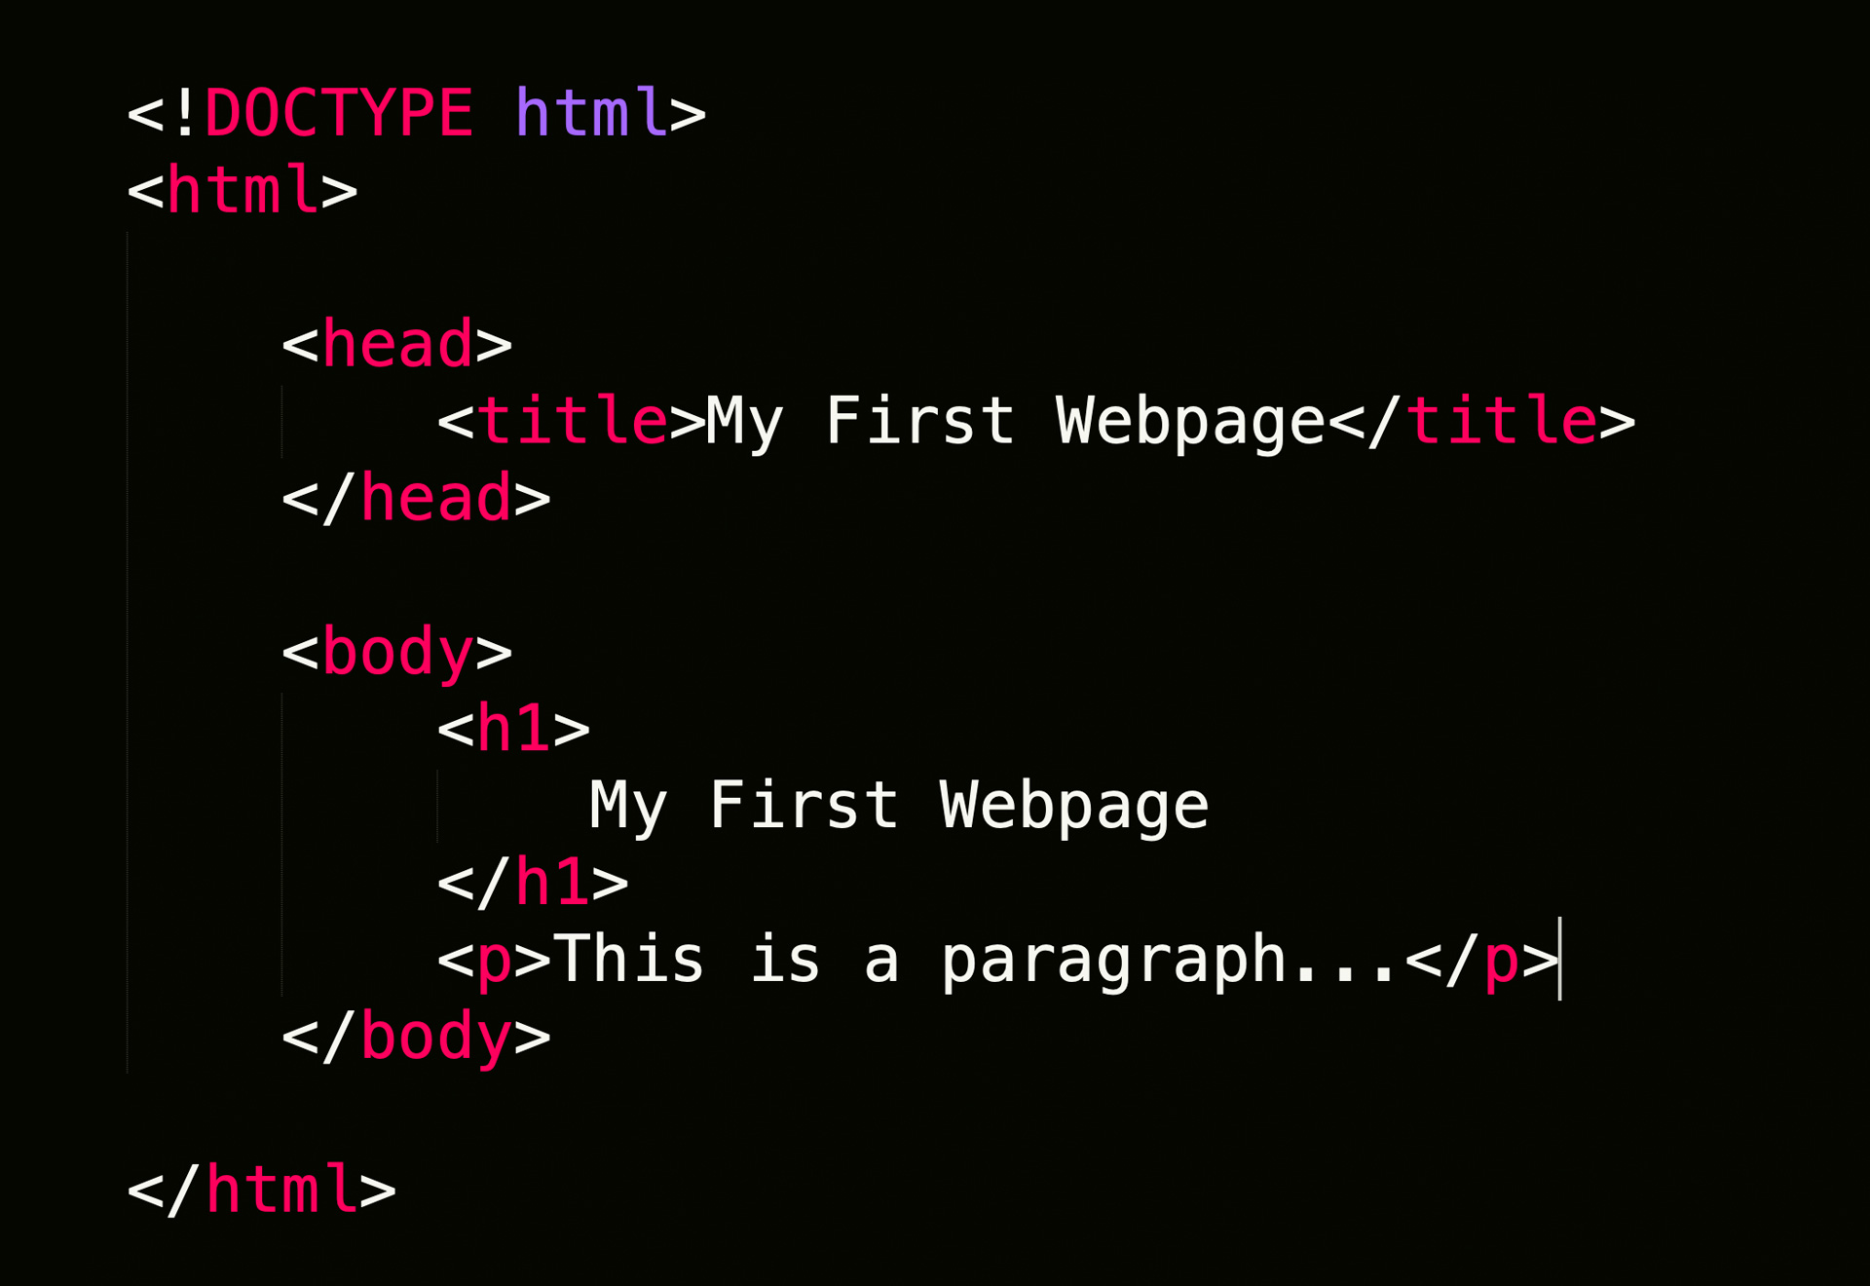
Notes:
My hope is that this is a brainstorm session and that you have actionable take aways.
Get feedback on your pitch from Mark Cuban

Slide 9
Notes:
My hope is that this is a brainstorm session and that you have actionable take aways.
Get feedback on your pitch from Mark Cuban

Slide 10
Notes:
My hope is that this is a brainstorm session and that you have actionable take aways.
Get feedback on your pitch from Mark Cuban

Slide 11
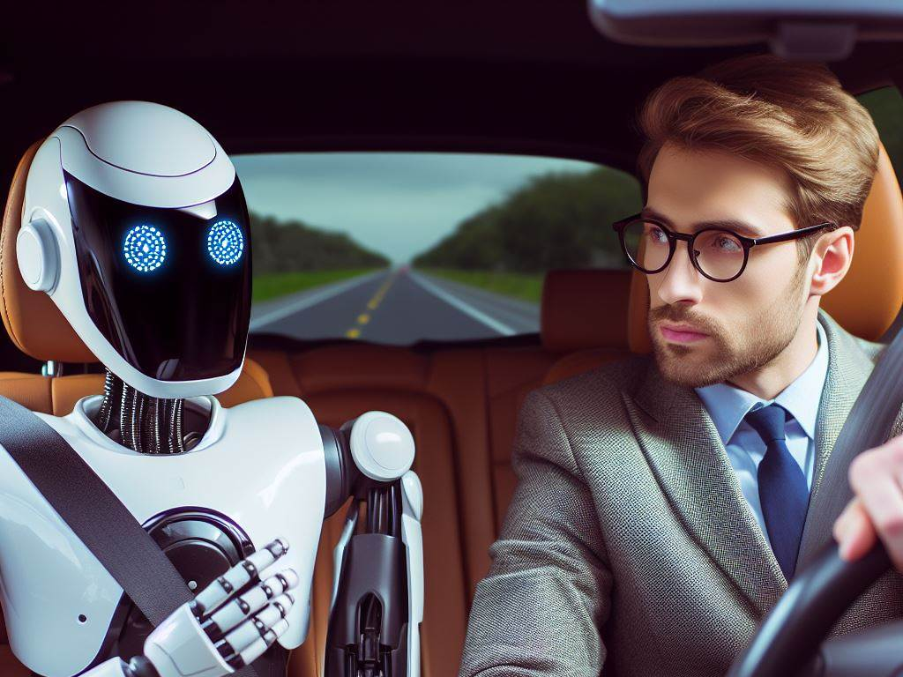
Notes:
Prep for your classes on the commute

Slide 12
Question
Is this idea worth pursuing?

Slide 13
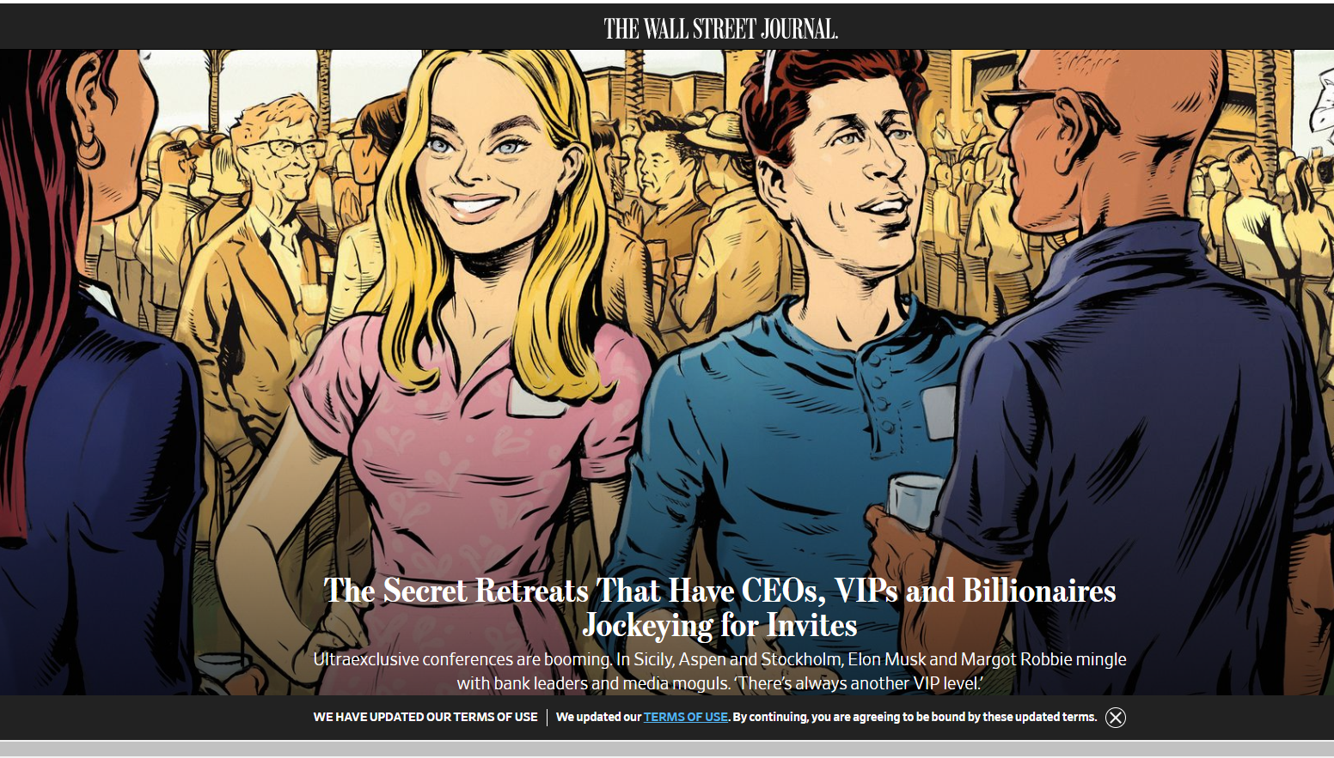
Assignment Examples
Notes:
Get the TAM for an idea and decide if it’s worth it

Slide 14
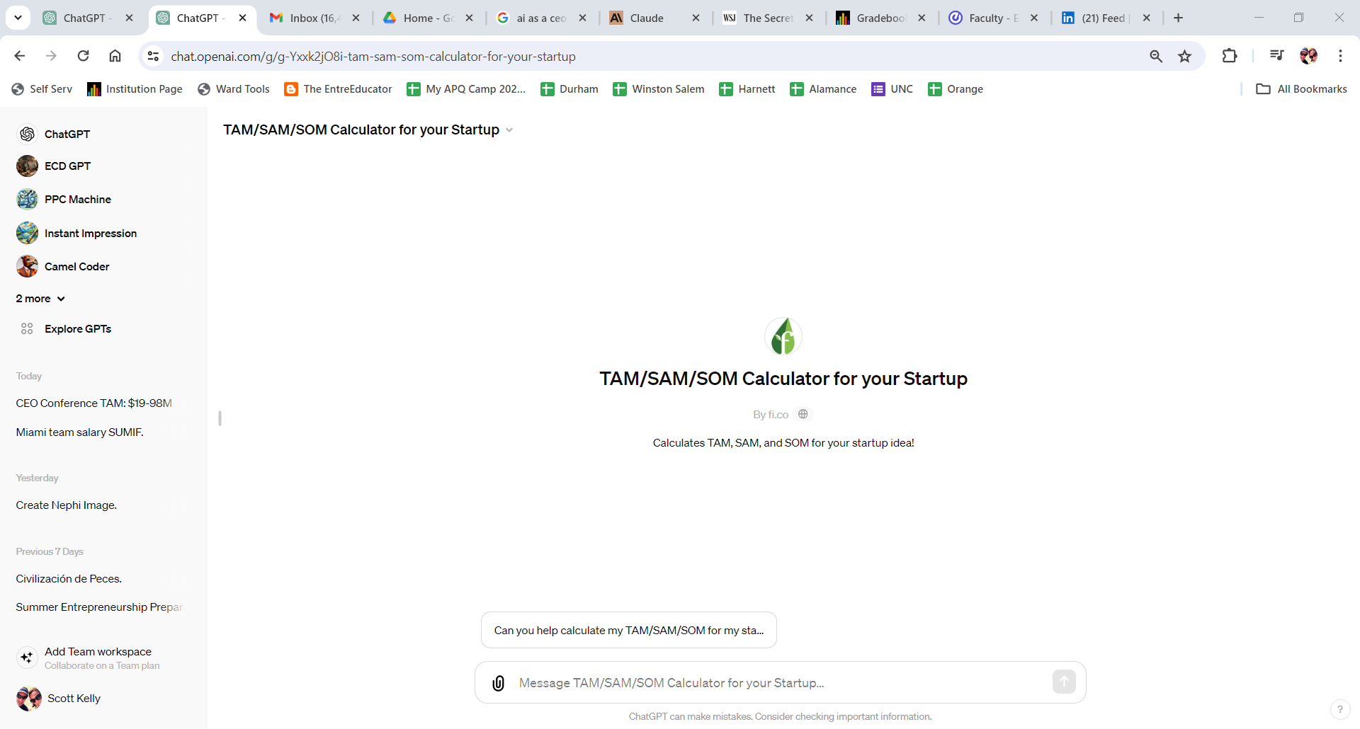
Assignment Examples
Notes:
Get feedback on your pitch from Mark Cuban

Slide 15
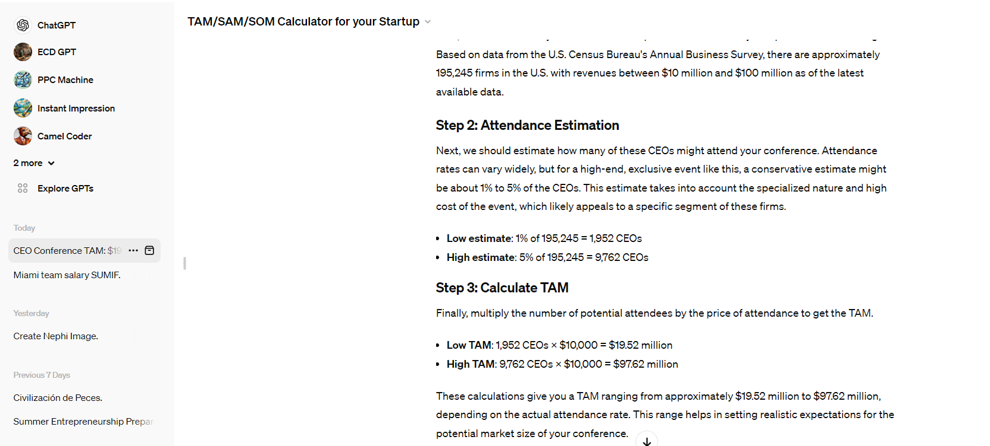
Assignment Examples
Notes:
Get feedback on your pitch from Mark Cuban

Slide 16
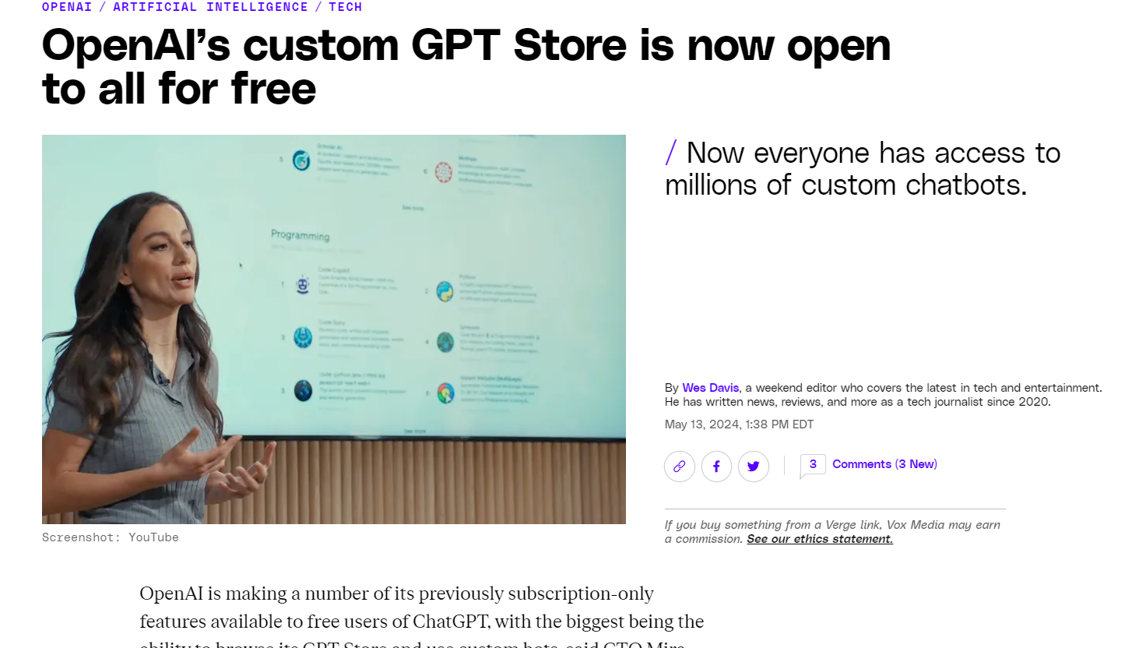
Announced Yesterday
Notes:
Get feedback on your pitch from Mark Cuban

Slide 17
Assignment Examples
What can you accomplish in
60 seconds with AI?
Notes:
Helping communities and individuals through….here’s why invest and here’s why we need to connect disadvantaged…Social Impact
4/1
Beginning – how bad things are in rural areas and in the middle are steps that make it possible
Two Americas – Rural and Urban, We can let collapse, America is about individual taking care of their lives, rural America is missing access to ecosystems/infrastructure that enables e-ship
Growth in small biz
Then…paint picture of disadvantaged….access to capital/networks, vision, lack of motivation/role models

Slide 18
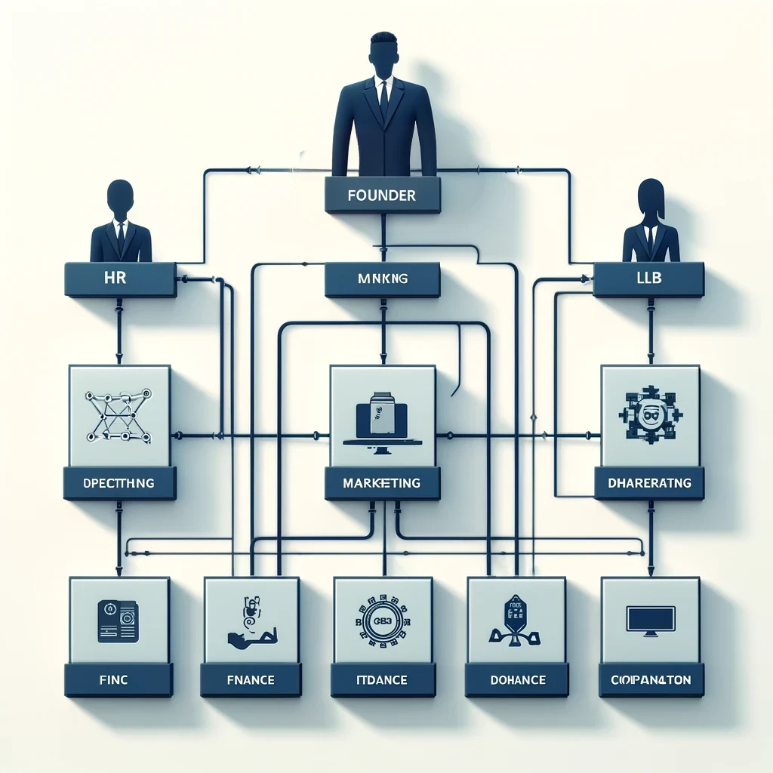
Notes:
How does AI change the startup process? I enables solo founders and students to do more with less time and resources.

Slide 19
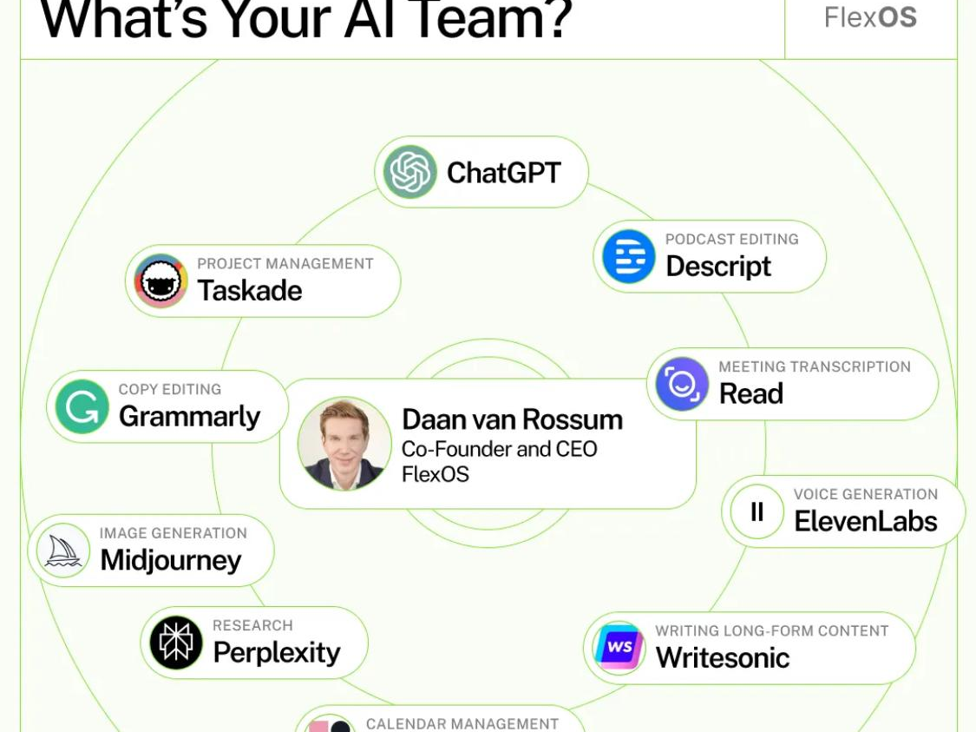
Notes:
How does AI change the startup process? I enables solo founders and students to do more with less time and resources.

Slide 20
Notes:
Helping communities and individuals through….here’s why invest and here’s why we need to connect disadvantaged…Social Impact
4/1
Beginning – how bad things are in rural areas and in the middle are steps that make it possible
Two Americas – Rural and Urban, We can let collapse, America is about individual taking care of their lives, rural America is missing access to ecosystems/infrastructure that enables e-ship
Growth in small biz
Then…paint picture of disadvantaged….access to capital/networks, vision, lack of motivation/role models

Slide 21
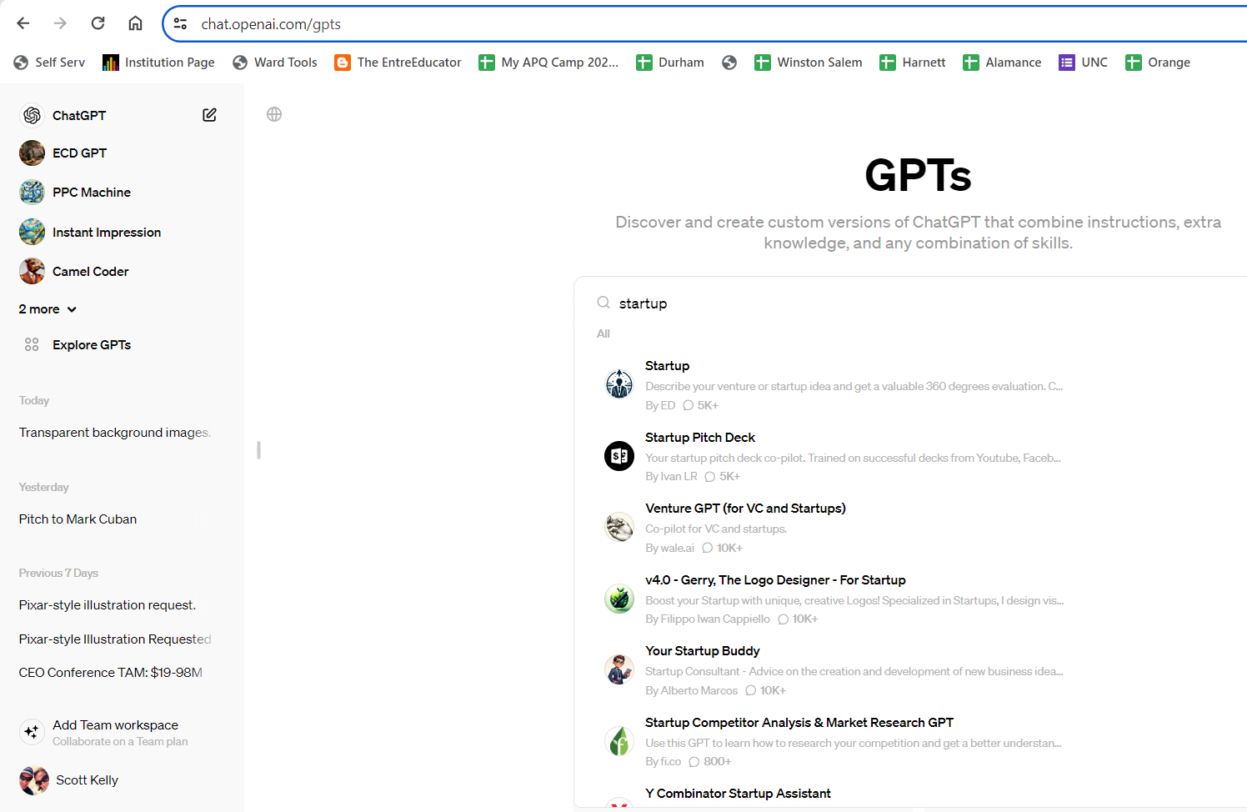
Notes:
Helping communities and individuals through….here’s why invest and here’s why we need to connect disadvantaged…Social Impact
4/1
Beginning – how bad things are in rural areas and in the middle are steps that make it possible
Two Americas – Rural and Urban, We can let collapse, America is about individual taking care of their lives, rural America is missing access to ecosystems/infrastructure that enables e-ship
Growth in small biz
Then…paint picture of disadvantaged….access to capital/networks, vision, lack of motivation/role models

Slide 22
Conclusion
AI is likely more important in entrepreneurship education than in any other discipline.
Notes:
Helping communities and individuals through….here’s why invest and here’s why we need to connect disadvantaged…Social Impact
4/1
Beginning – how bad things are in rural areas and in the middle are steps that make it possible
Two Americas – Rural and Urban, We can let collapse, America is about individual taking care of their lives, rural America is missing access to ecosystems/infrastructure that enables e-ship
Growth in small biz
Then…paint picture of disadvantaged….access to capital/networks, vision, lack of motivation/role models

Slide 23
Contact Info
Scott Kelly
skelly@campbell.edu
Notes:
Helping communities and individuals through….here’s why invest and here’s why we need to connect disadvantaged…Social Impact
4/1
Beginning – how bad things are in rural areas and in the middle are steps that make it possible
Two Americas – Rural and Urban, We can let collapse, America is about individual taking care of their lives, rural America is missing access to ecosystems/infrastructure that enables e-ship
Growth in small biz
Then…paint picture of disadvantaged….access to capital/networks, vision, lack of motivation/role models

Slide 24
Agenda
Assess the Room via Questions
Demonstrate 1 or more of the use cases:
Pi – Voice Function
Feedback on Pitch
Prep for Lecture/Dialogue
Customer Interviews
Custom GPTs
Persona
Brainstorming & Creativity
Alternative function of a tooth brush
Feedback from Mark Cuban
Questions

