Slide 1
What is Artificial Intelligence?
Curry Guinn

Slide 2
What we’ll talk about
What are some definitions of AI?
Quick review of the state-of-the-art

Slide 3
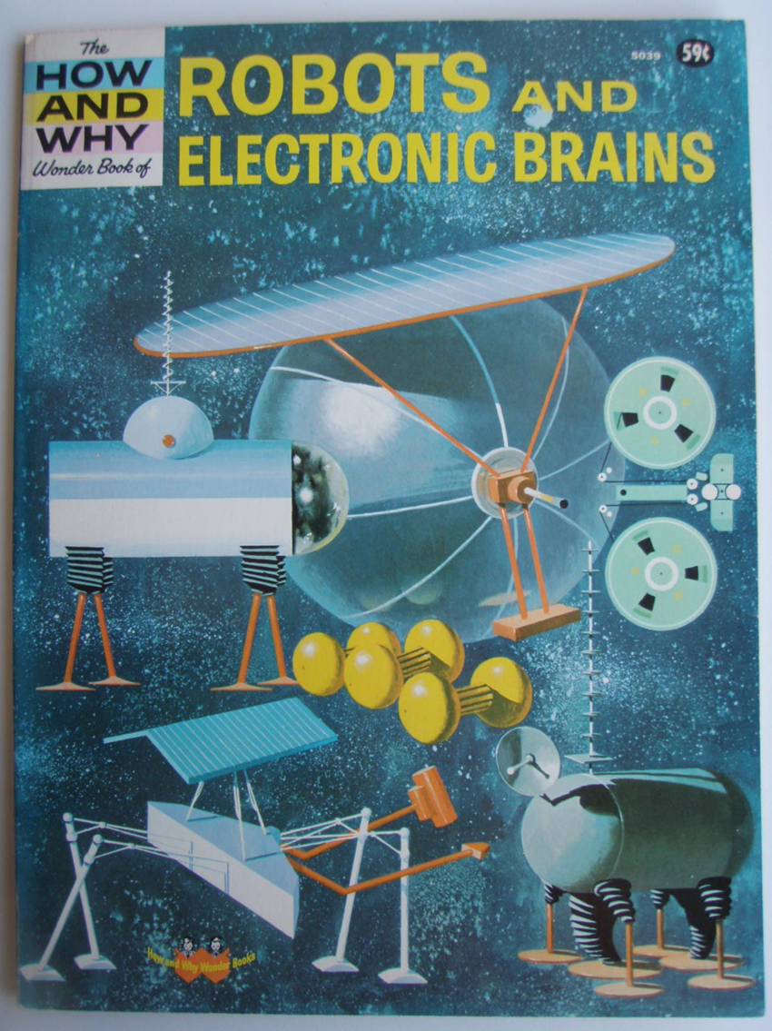
Is Artificial Intelligence Everything in Computer Science?
Can you think of a being that can do the things a computer can do that is not intelligent on some scale?
So why do we lump certain things that computers can do under the category of Artificial Intelligence?

Slide 4
How Big is the Field of AI?
Abductive reasoning
Adaptive Systems
Affective Computing
Artificial Art
Artificial Creativity
Artificial life
Automated reasoning
Automation
Belief networks
Biologically-inspired computing
Case-based reasoning
Cognitive science
Common-sense reasoning
Computer vision
Concept mining
Constraint satisfaction
Data integration
Data mining
Decision theory
Decision trees
Deep learning
Diagnosis
Dialog systems
Discourse modeling
E-mail filtering
Expert systems
Face recognition
Fuzzy logic
Game playing
Game theory
Genetic algorithms
Genetic Programming
Gesture Recognition
Handwriting recognition
Heuristic search
Human computer interaction
Hybrid intelligence
Information extraction
Information retrieval
Intelligent agents
Intelligent control
Intelligent user interfaces
Lifelike characters
LiSP
Logic programming
Knowledge representation
Machine learning
Machine translation
Membrane computing
Multi-agent systems
Natural language processing
Neural networks
Non-linear control
Nonmonotonic reasoning
Optical character recognition
Pattern recognition
Philosophy of AI
Planning
Probabilistic reasoning
Prolog
Reactive control
Reinforcement learning
Robotics
Scheduling
Semantic networks
Semantic Web
Sensor networks
Spatial reasoning
Speech recognition
Swarm intelligence
Temporal reasoning
Theorem proving
Unmanned vehicles
User Modeling
Web mining
Web search

Slide 5
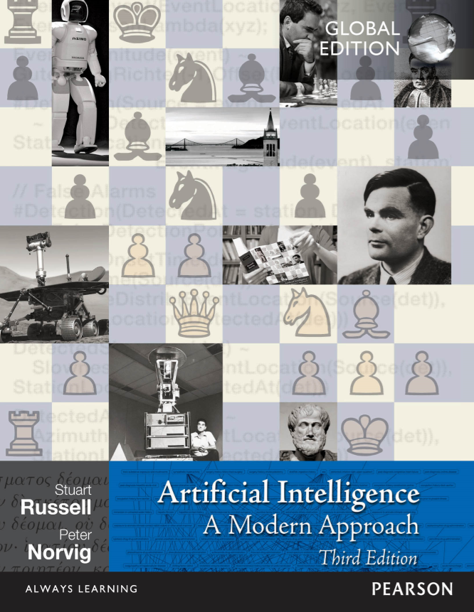
An approach that follows Russell (UC-Berkeley) and Norvig (Stanford) [with side tangents]

Slide 6
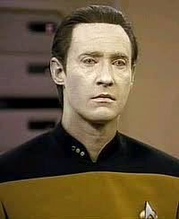
Thinking Humanly
Modeling (usually) human cognition.
Cognitive science.
Often, people argue that to be intelligent a machine must have consciousness.

Slide 7
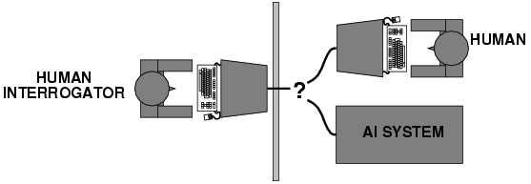
Acting Humanly
Behaviorist approach.
How do we know anything (besides ourselves) is intelligent?
Through observing behavior!
The Turing Test (Alan Turing, 1950).

Slide 8
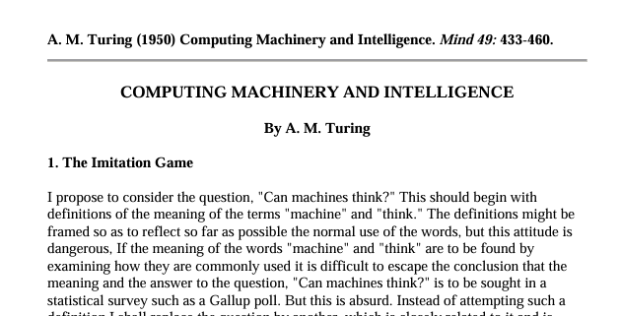
The Turing Test
1950: The Turing Test for machine intelligence
How do you know if something is intelligent?

Slide 9
The Imitation Game
Which is man, and which is woman???
Which is machine, and which is woman???
Which is machine, and which is human???
Conversation…
Conversation…

Slide 10
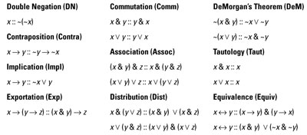
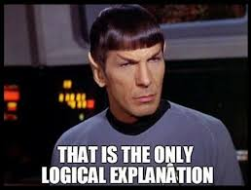
Thinking Rationally
Logic, logic, logic.
Formalize the world, and then use well-known techniques to solve problems.
Notice that this is not “thinking humanly”.

Slide 11
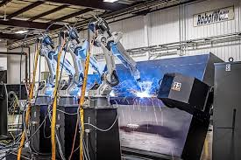
Acting Rationally
More than just using “correct inference”.
An agent is a system that perceives and acts
An agent acts rationally if it always does “the right thing” based on its available knowledge and beliefs.
Decision-making may use logic, but it may have to go beyond logically reasoning
Very problem-centric approach

Slide 12
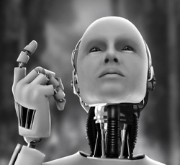
Artificial General Intelligence (AGI)
AI that can perform as well or better than humans in a wide range of cognitive tasks
Not just chess
Or face recognition
But all tasks that humans can do
Getting a computer to be “an intelligent being” or “an intelligence” is called Strong AI (or Hard AI).
As opposed to “Weak” or “Soft AI” which tries to get a machine to do a task that we think takes some level of intelligence to do

Slide 13
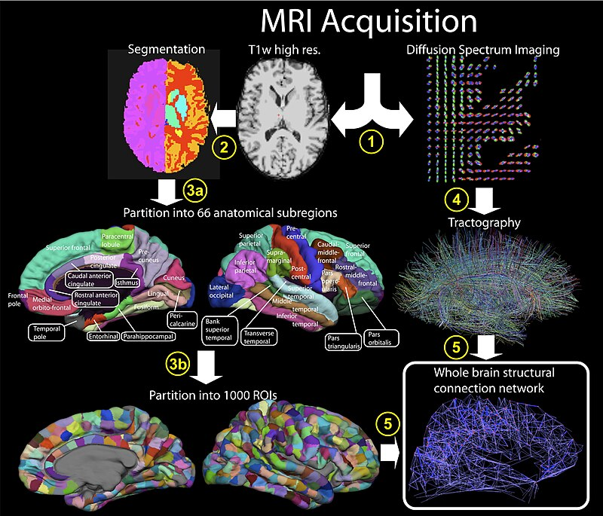
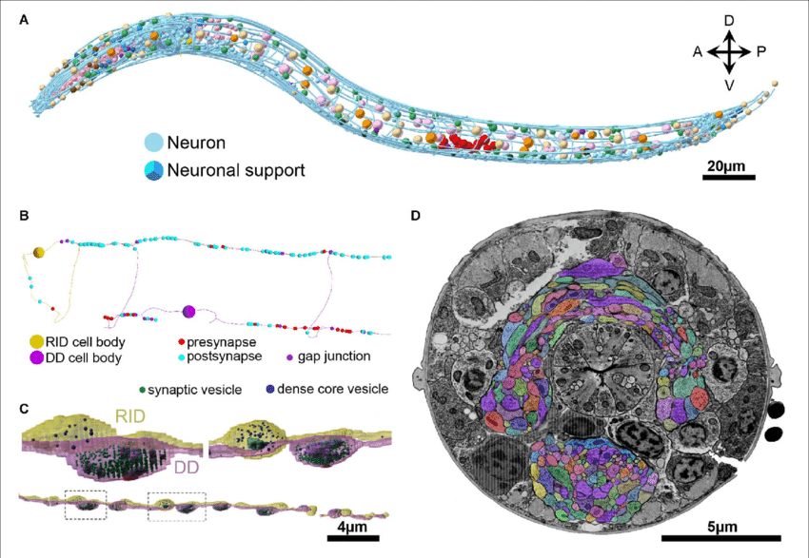
State-of-the-art in “Thinking Humanly”
Whole Brain Emulation
Where we want to be
Where we are

Slide 14
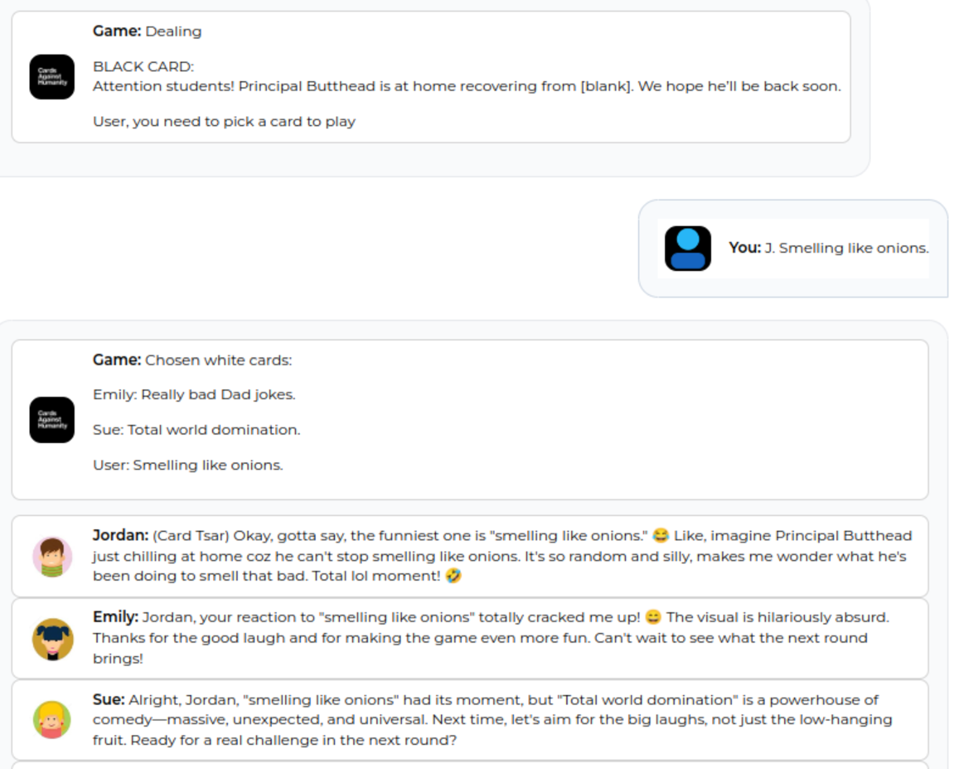
State-of-the-art in “Behaving Humanly”

Slide 15
State-of-the-art in “Behaving Humanly”

Slide 16
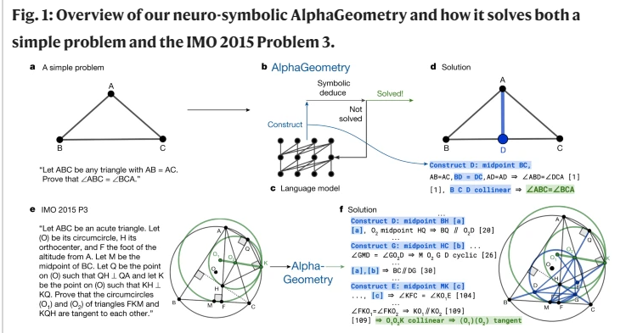
State-of-the-art in “Thinking Rationally”
Published: 17 January 2024
Solving olympiad geometry without human demonstrations

Slide 17
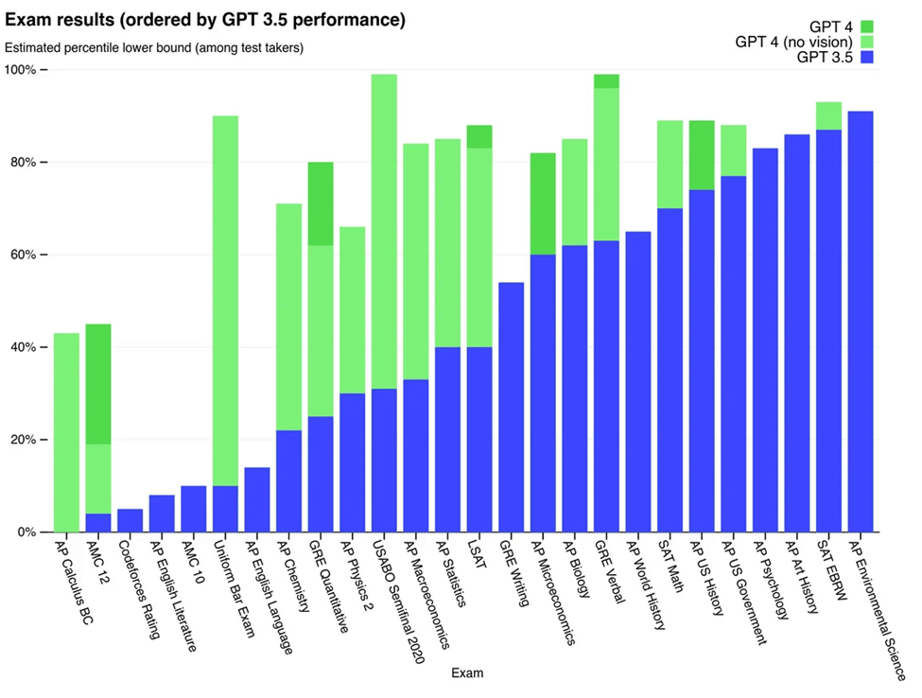
State-of-the-art in “Acting Rationally”

Slide 18
Artificial General Intelligence
Artificial General Intelligence Is Already Here October 10, 2023
Blaise Agüera y Arcas and Peter Norvig
“The most important parts of AGI have already been achieved by the current generation of advanced AI large language models.”

Slide 19
Artificial General Intelligence
Artificial General Intelligence Is Already Here October 10, 2023
Blaise Agüera y Arcas and Peter Norvig
“Frontier language models can perform competently at pretty much any information task that can be done by humans, can be posed and answered using natural language, and has quantifiable performance.”

Slide 20
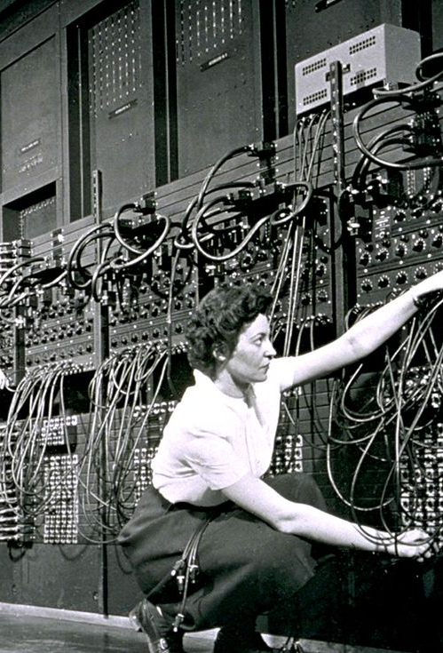
Artificial General Intelligence
Artificial General Intelligence Is Already Here October 10, 2023
Blaise Agüera y Arcas and Peter Norvig
“… [T]oday’s frontier models perform competently even on novel tasks they were not trained for, crossing a threshold that previous generations of AI and supervised deep learning systems never managed. Decades from now, they will be recognized as the first true examples of AGI, just as the 1945 ENIAC is now recognized as the first true general-purpose electronic computer.”

